Slide 1
Magnet Defect Inspection 2021/3/15
游凱任 Kai-Jen You
r10922170@ntu.edu.tw
0913880410

Slide 2
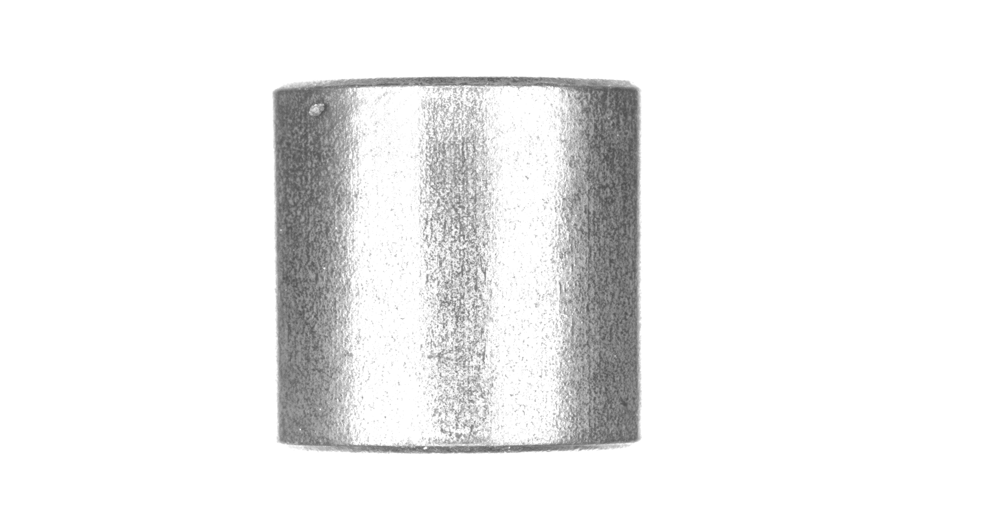
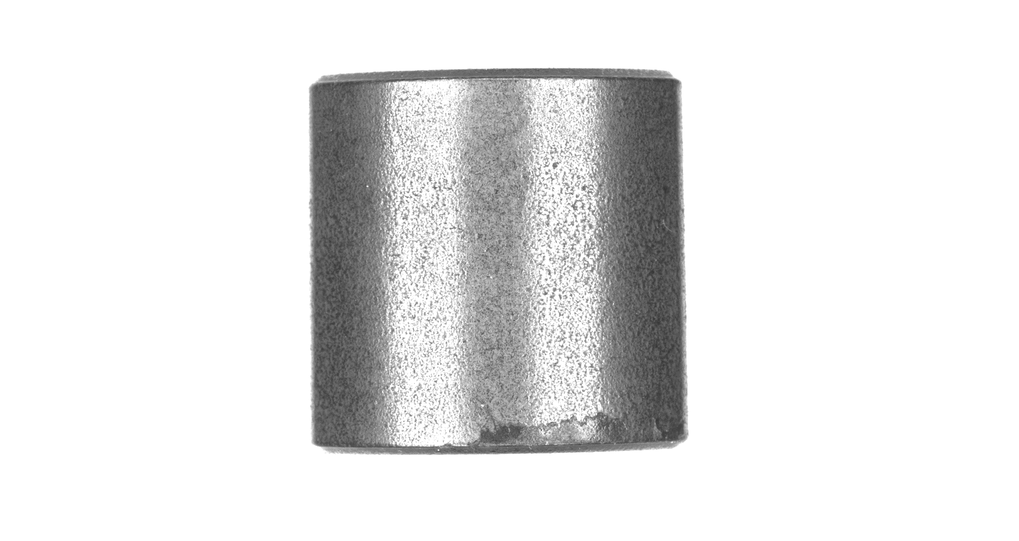
If the light above
The arc part is difficult to handle

Slide 3
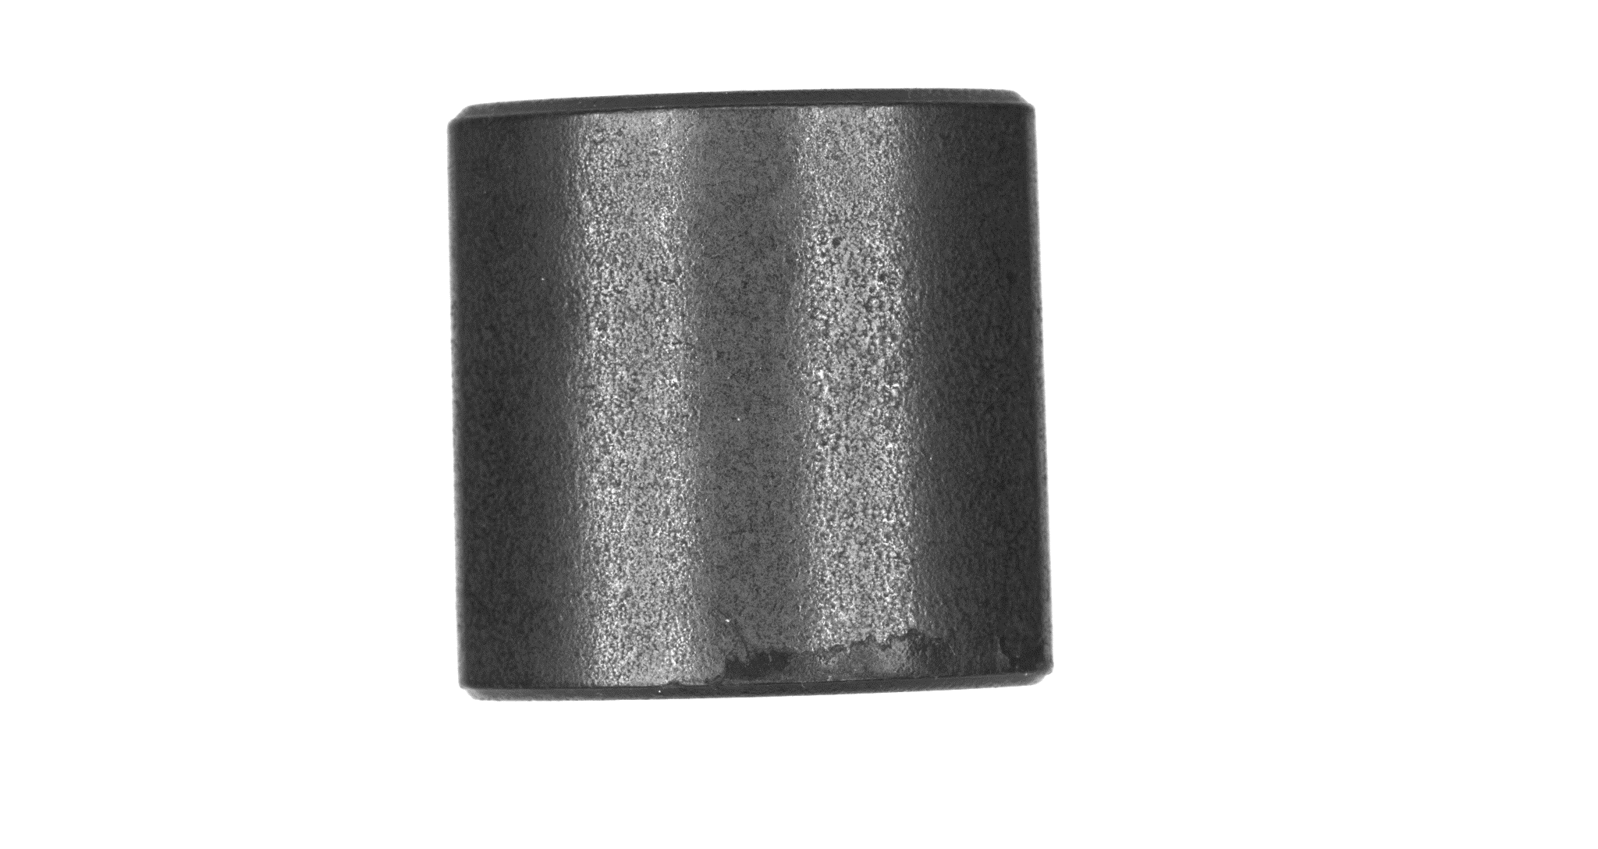
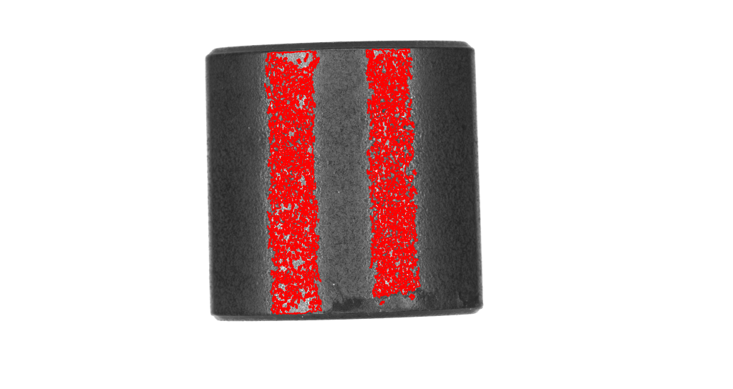
Difficult to find defect

Slide 4
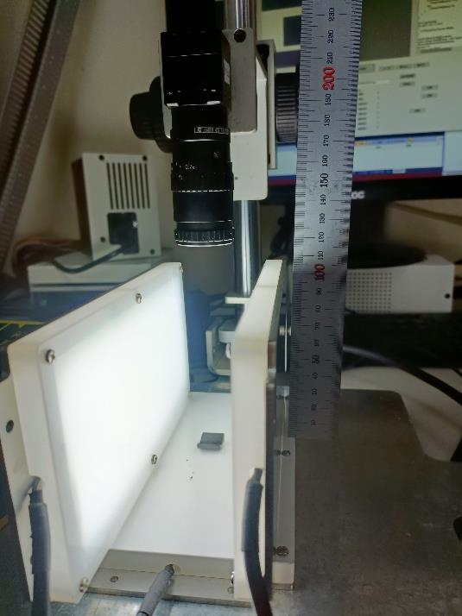
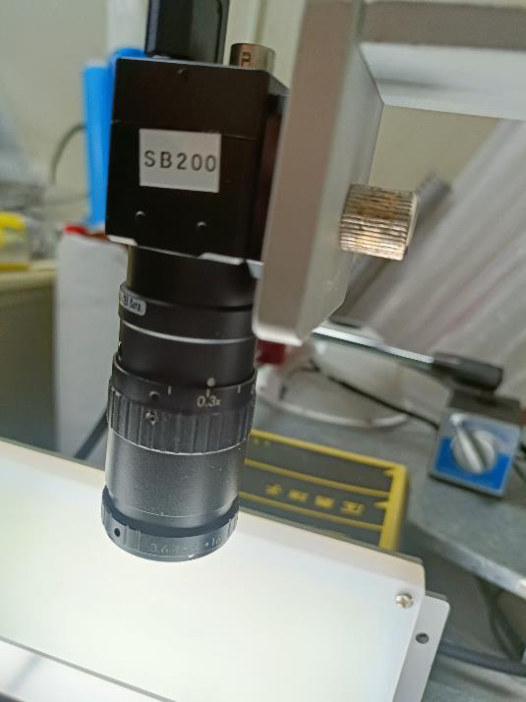
Environment

Slide 5
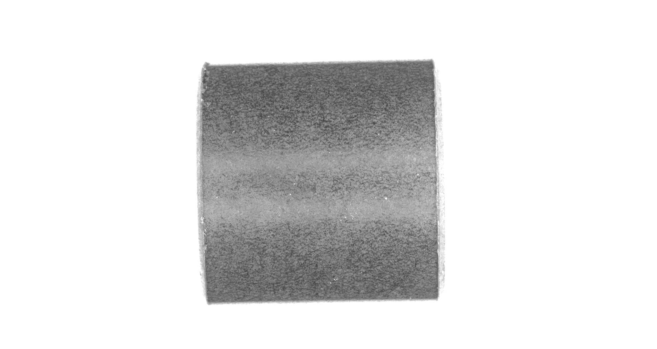
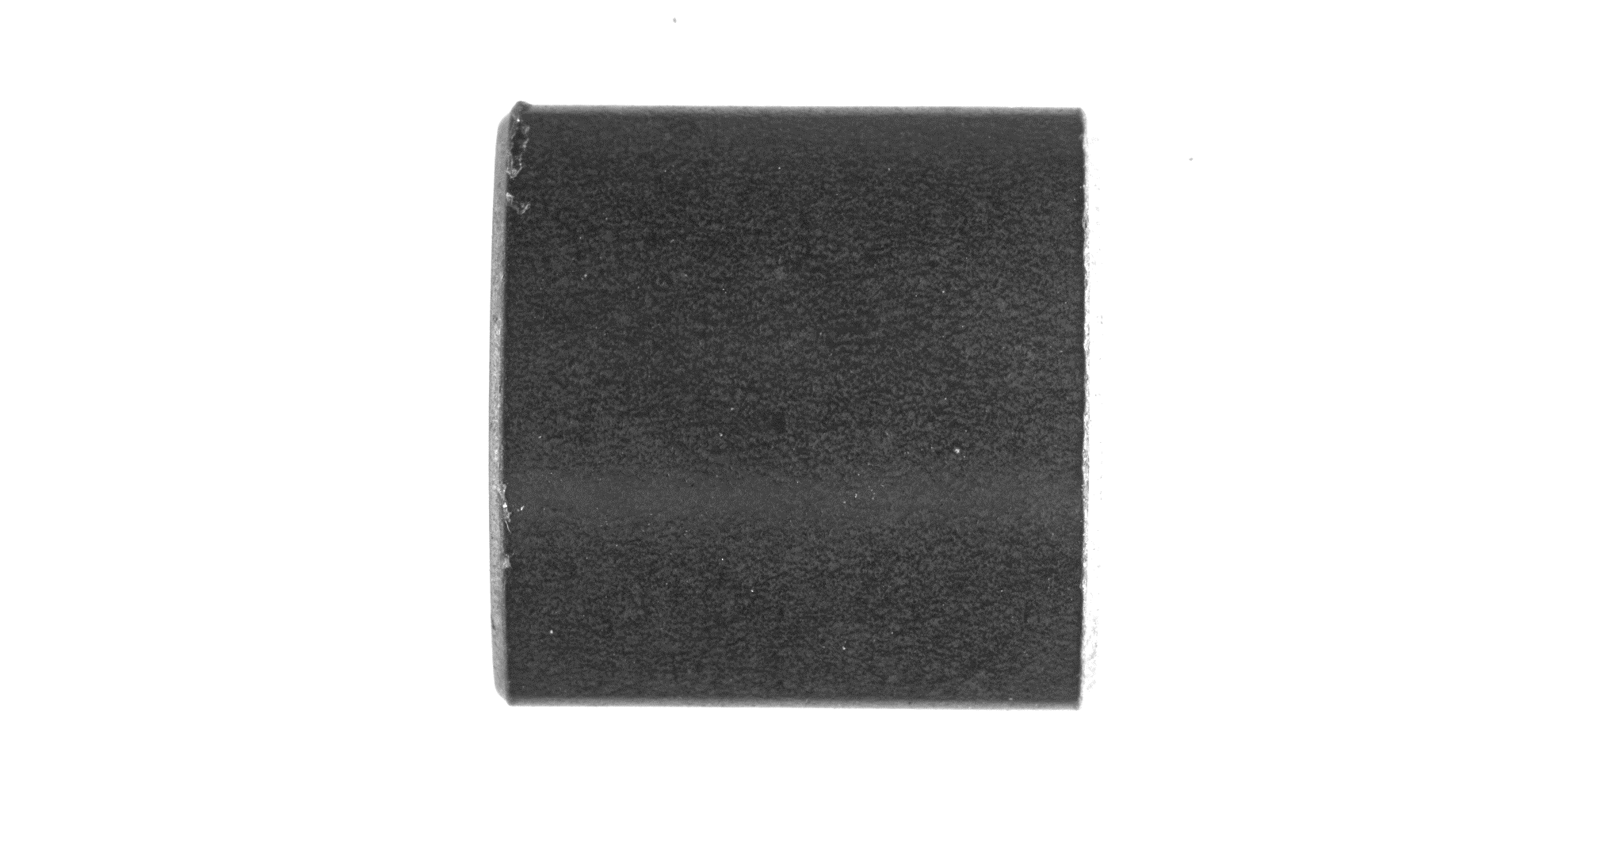
Almost succeed
But the arc part is blur

Slide 6
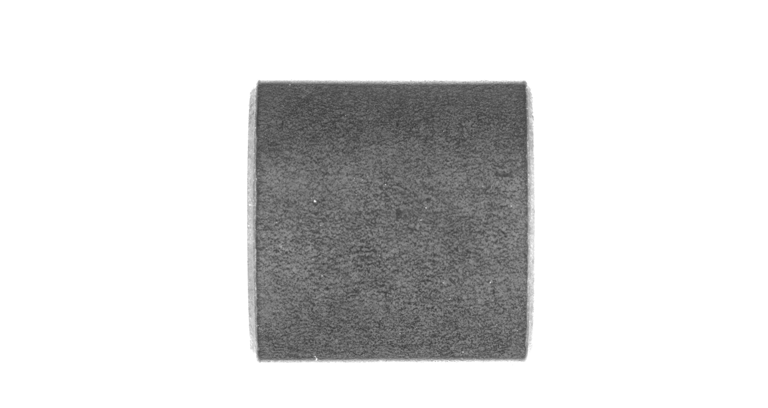
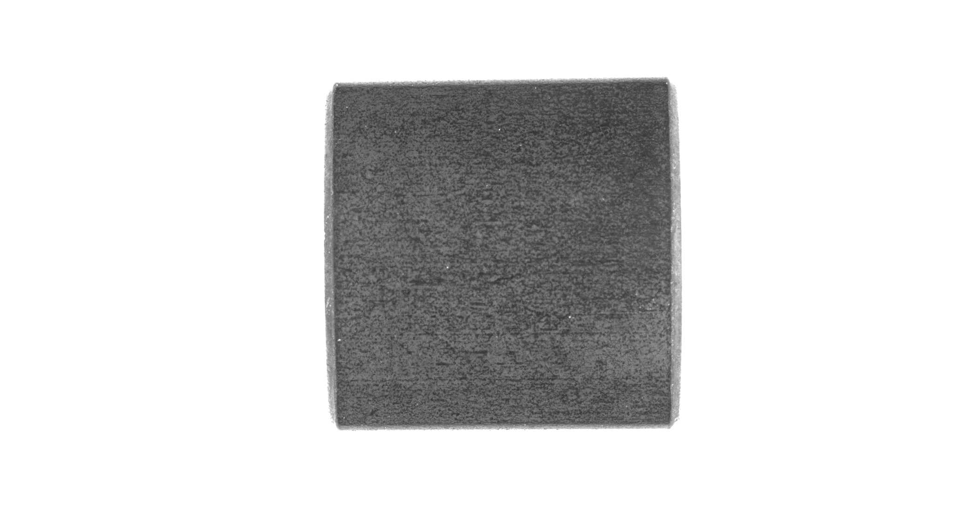
Finally, first 5 samples (outside)
Hard to detect defect on the outside

Slide 7
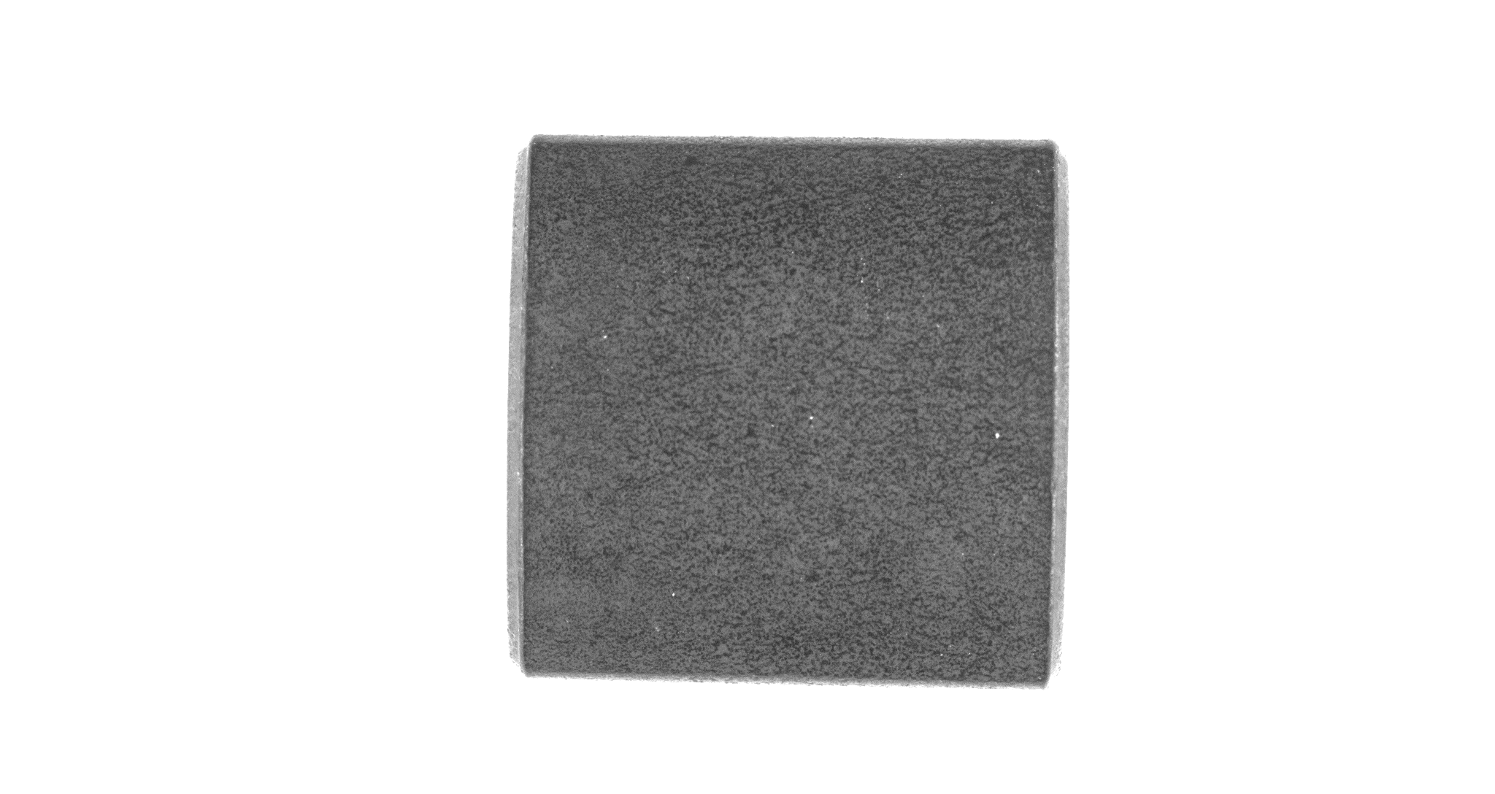
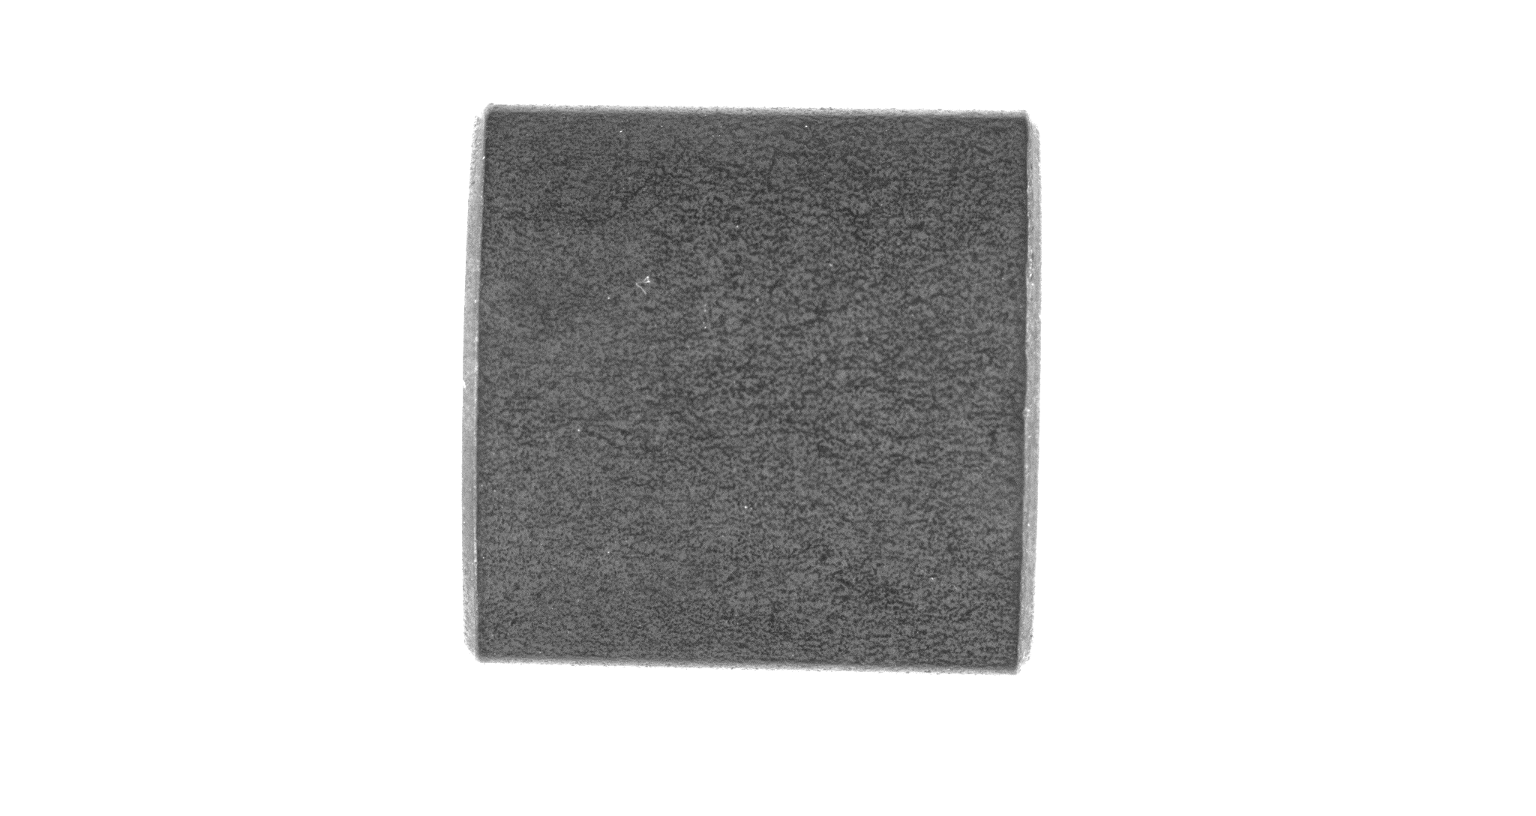
Hard to detect defect on the outside

Slide 8
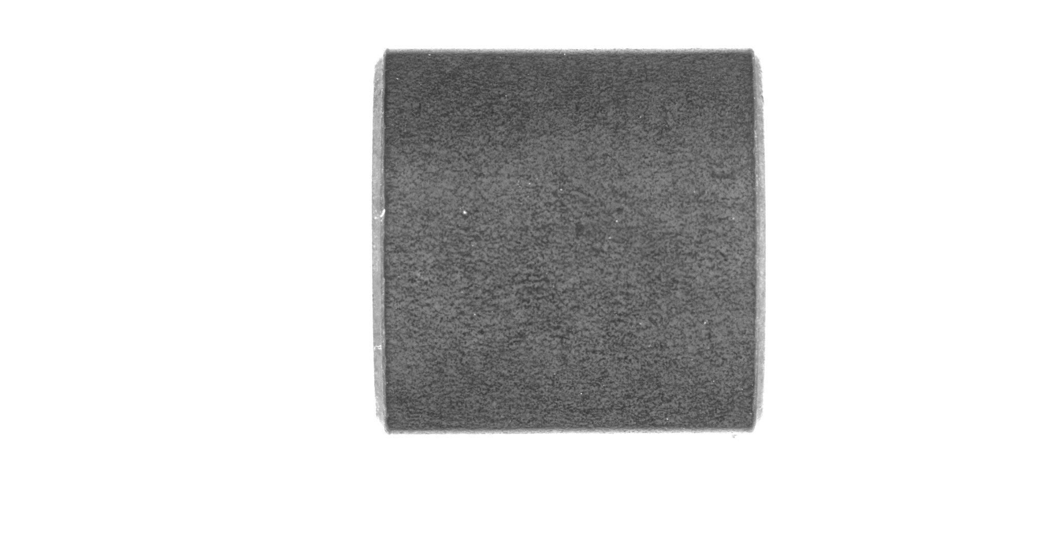
Hard to detect defect on the outside

Slide 9
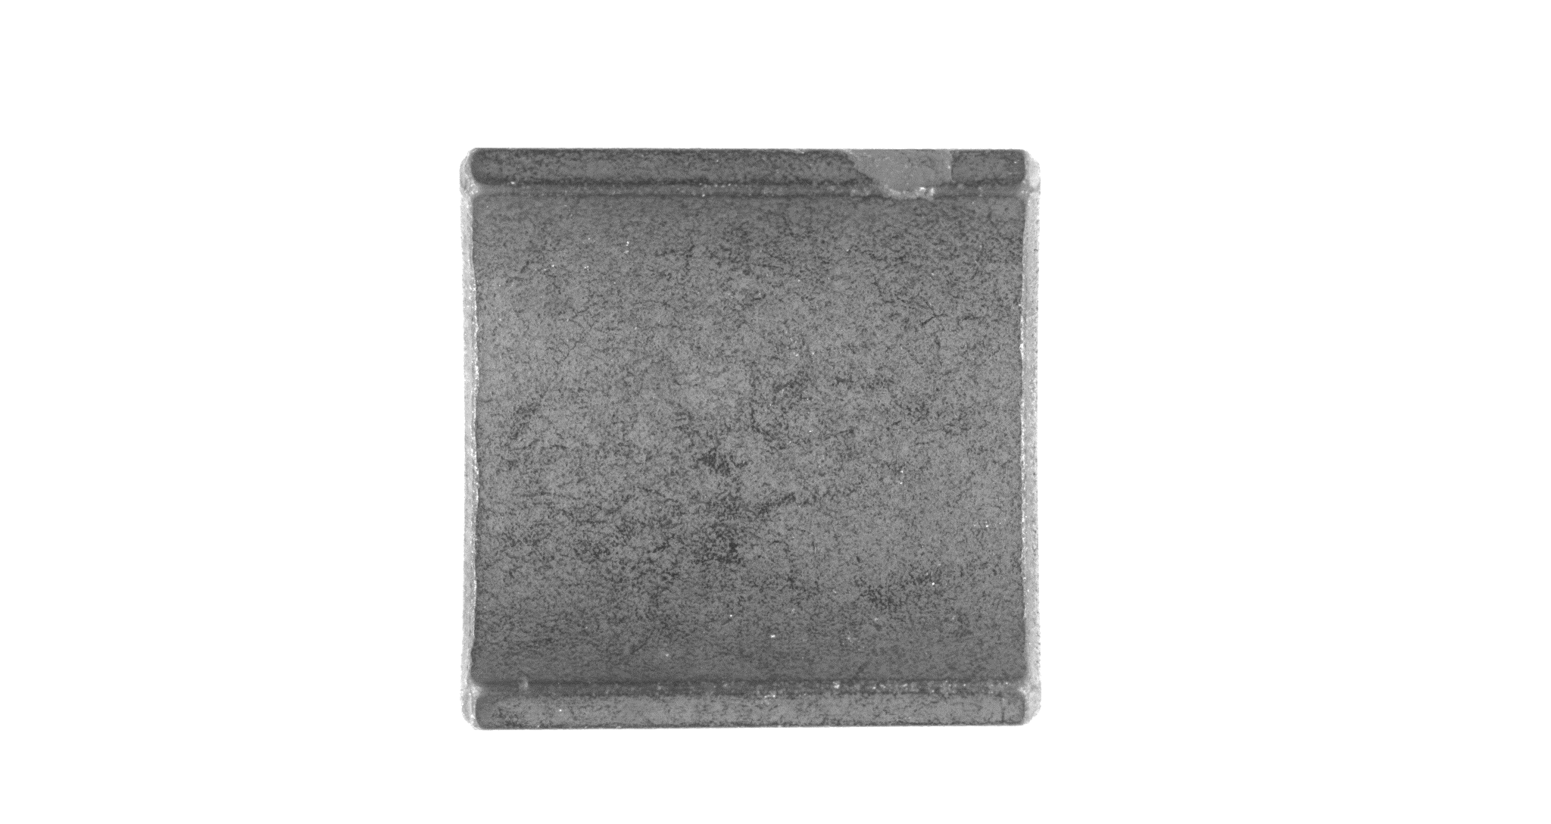
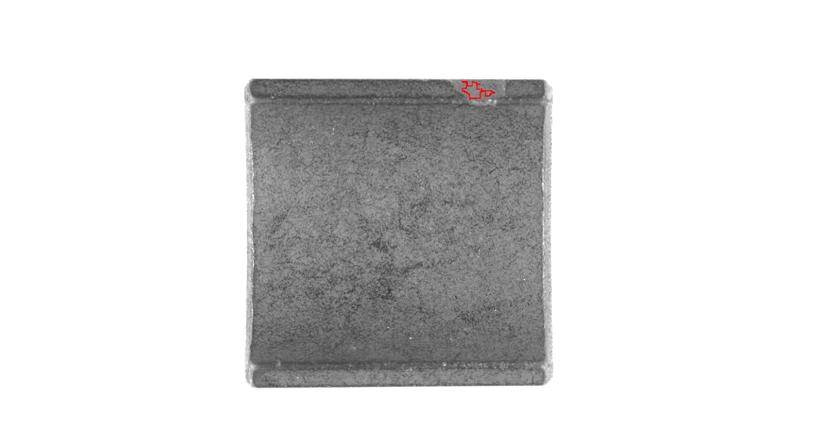
Inside
NG3

Slide 10
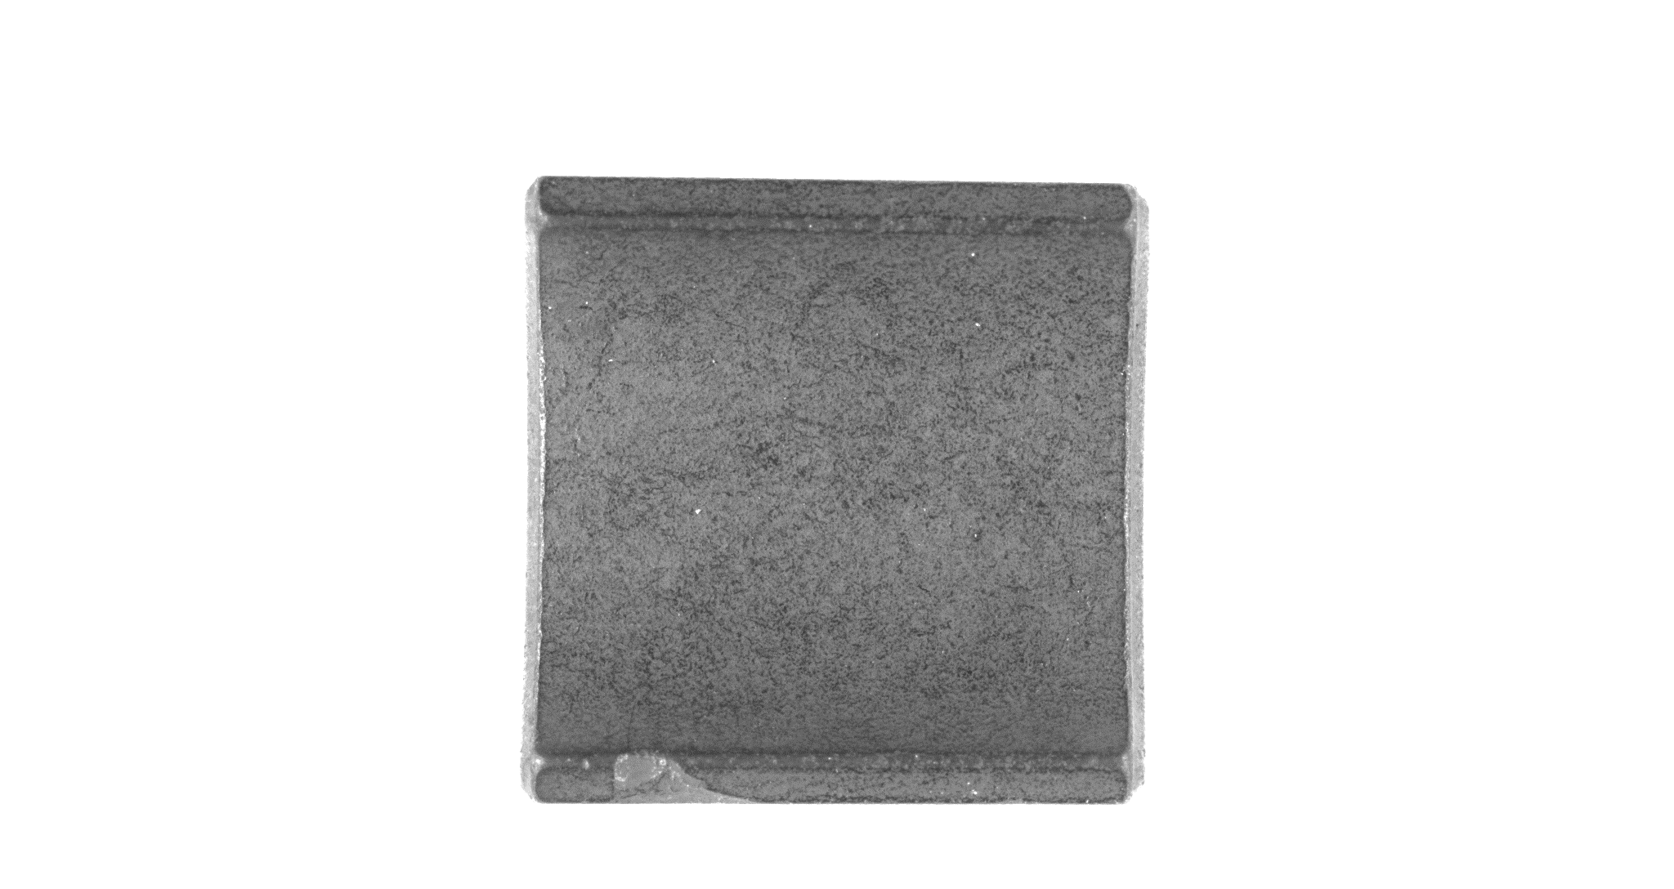
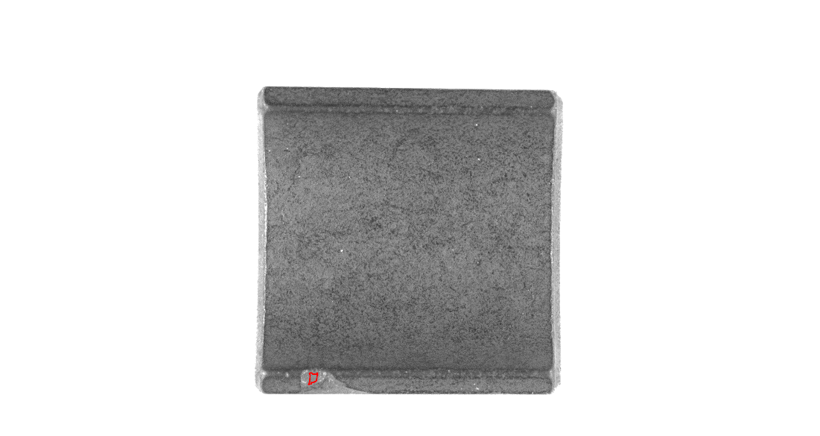
Inside
NG4

Slide 11
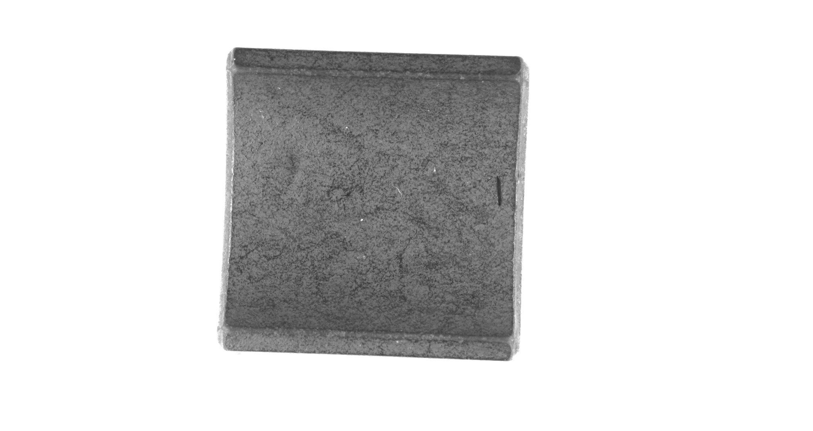
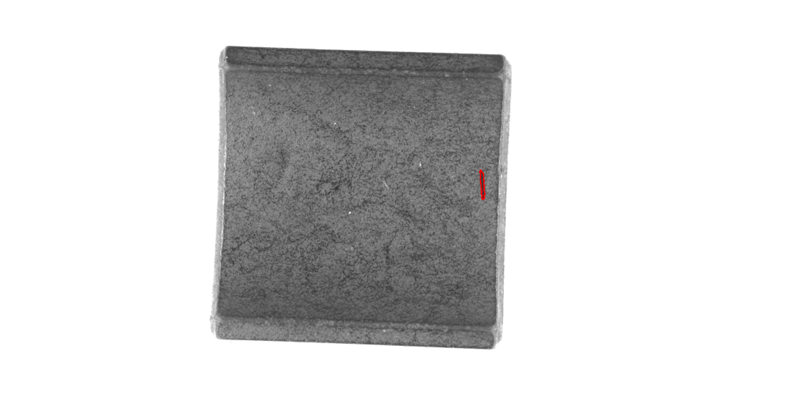
Inside
NG2

Slide 12
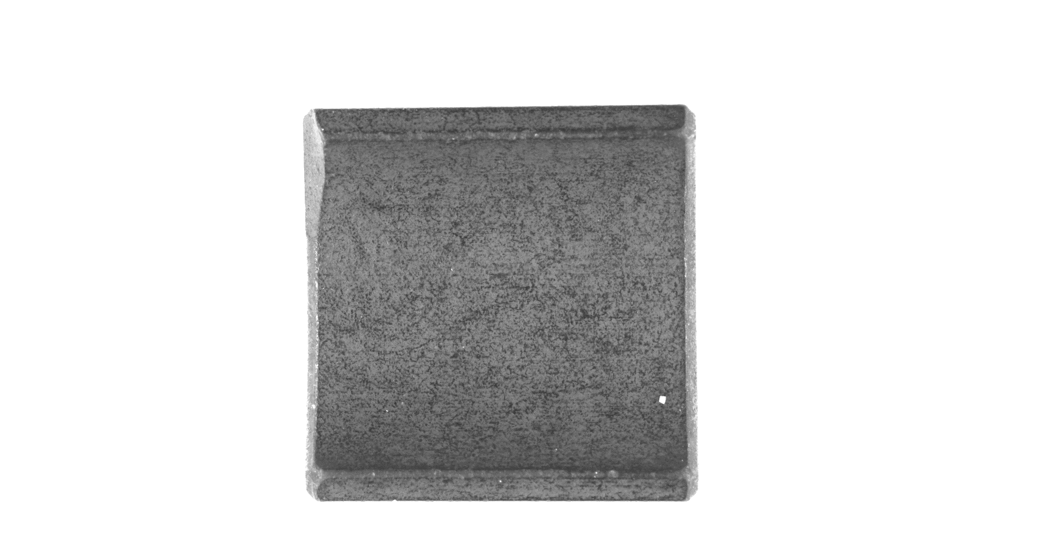

Hard to detect defect
NG1
Defect resembles its edge

Slide 13
2022/02/24 Get 100 good sample / 10 inside crack 10 inside hole / 40 inside missing corner 12 outside missing corner Try machine learning from https://github.com/openvinotoolkit/anomalib It is a pretrained model

Slide 14
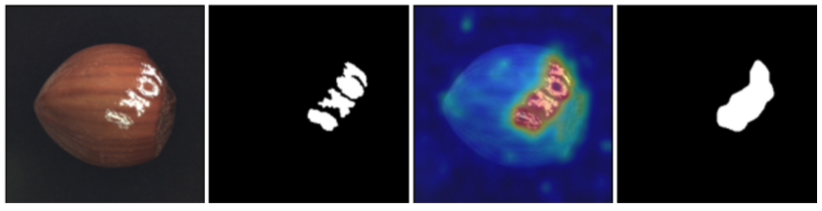
Result

Slide 15
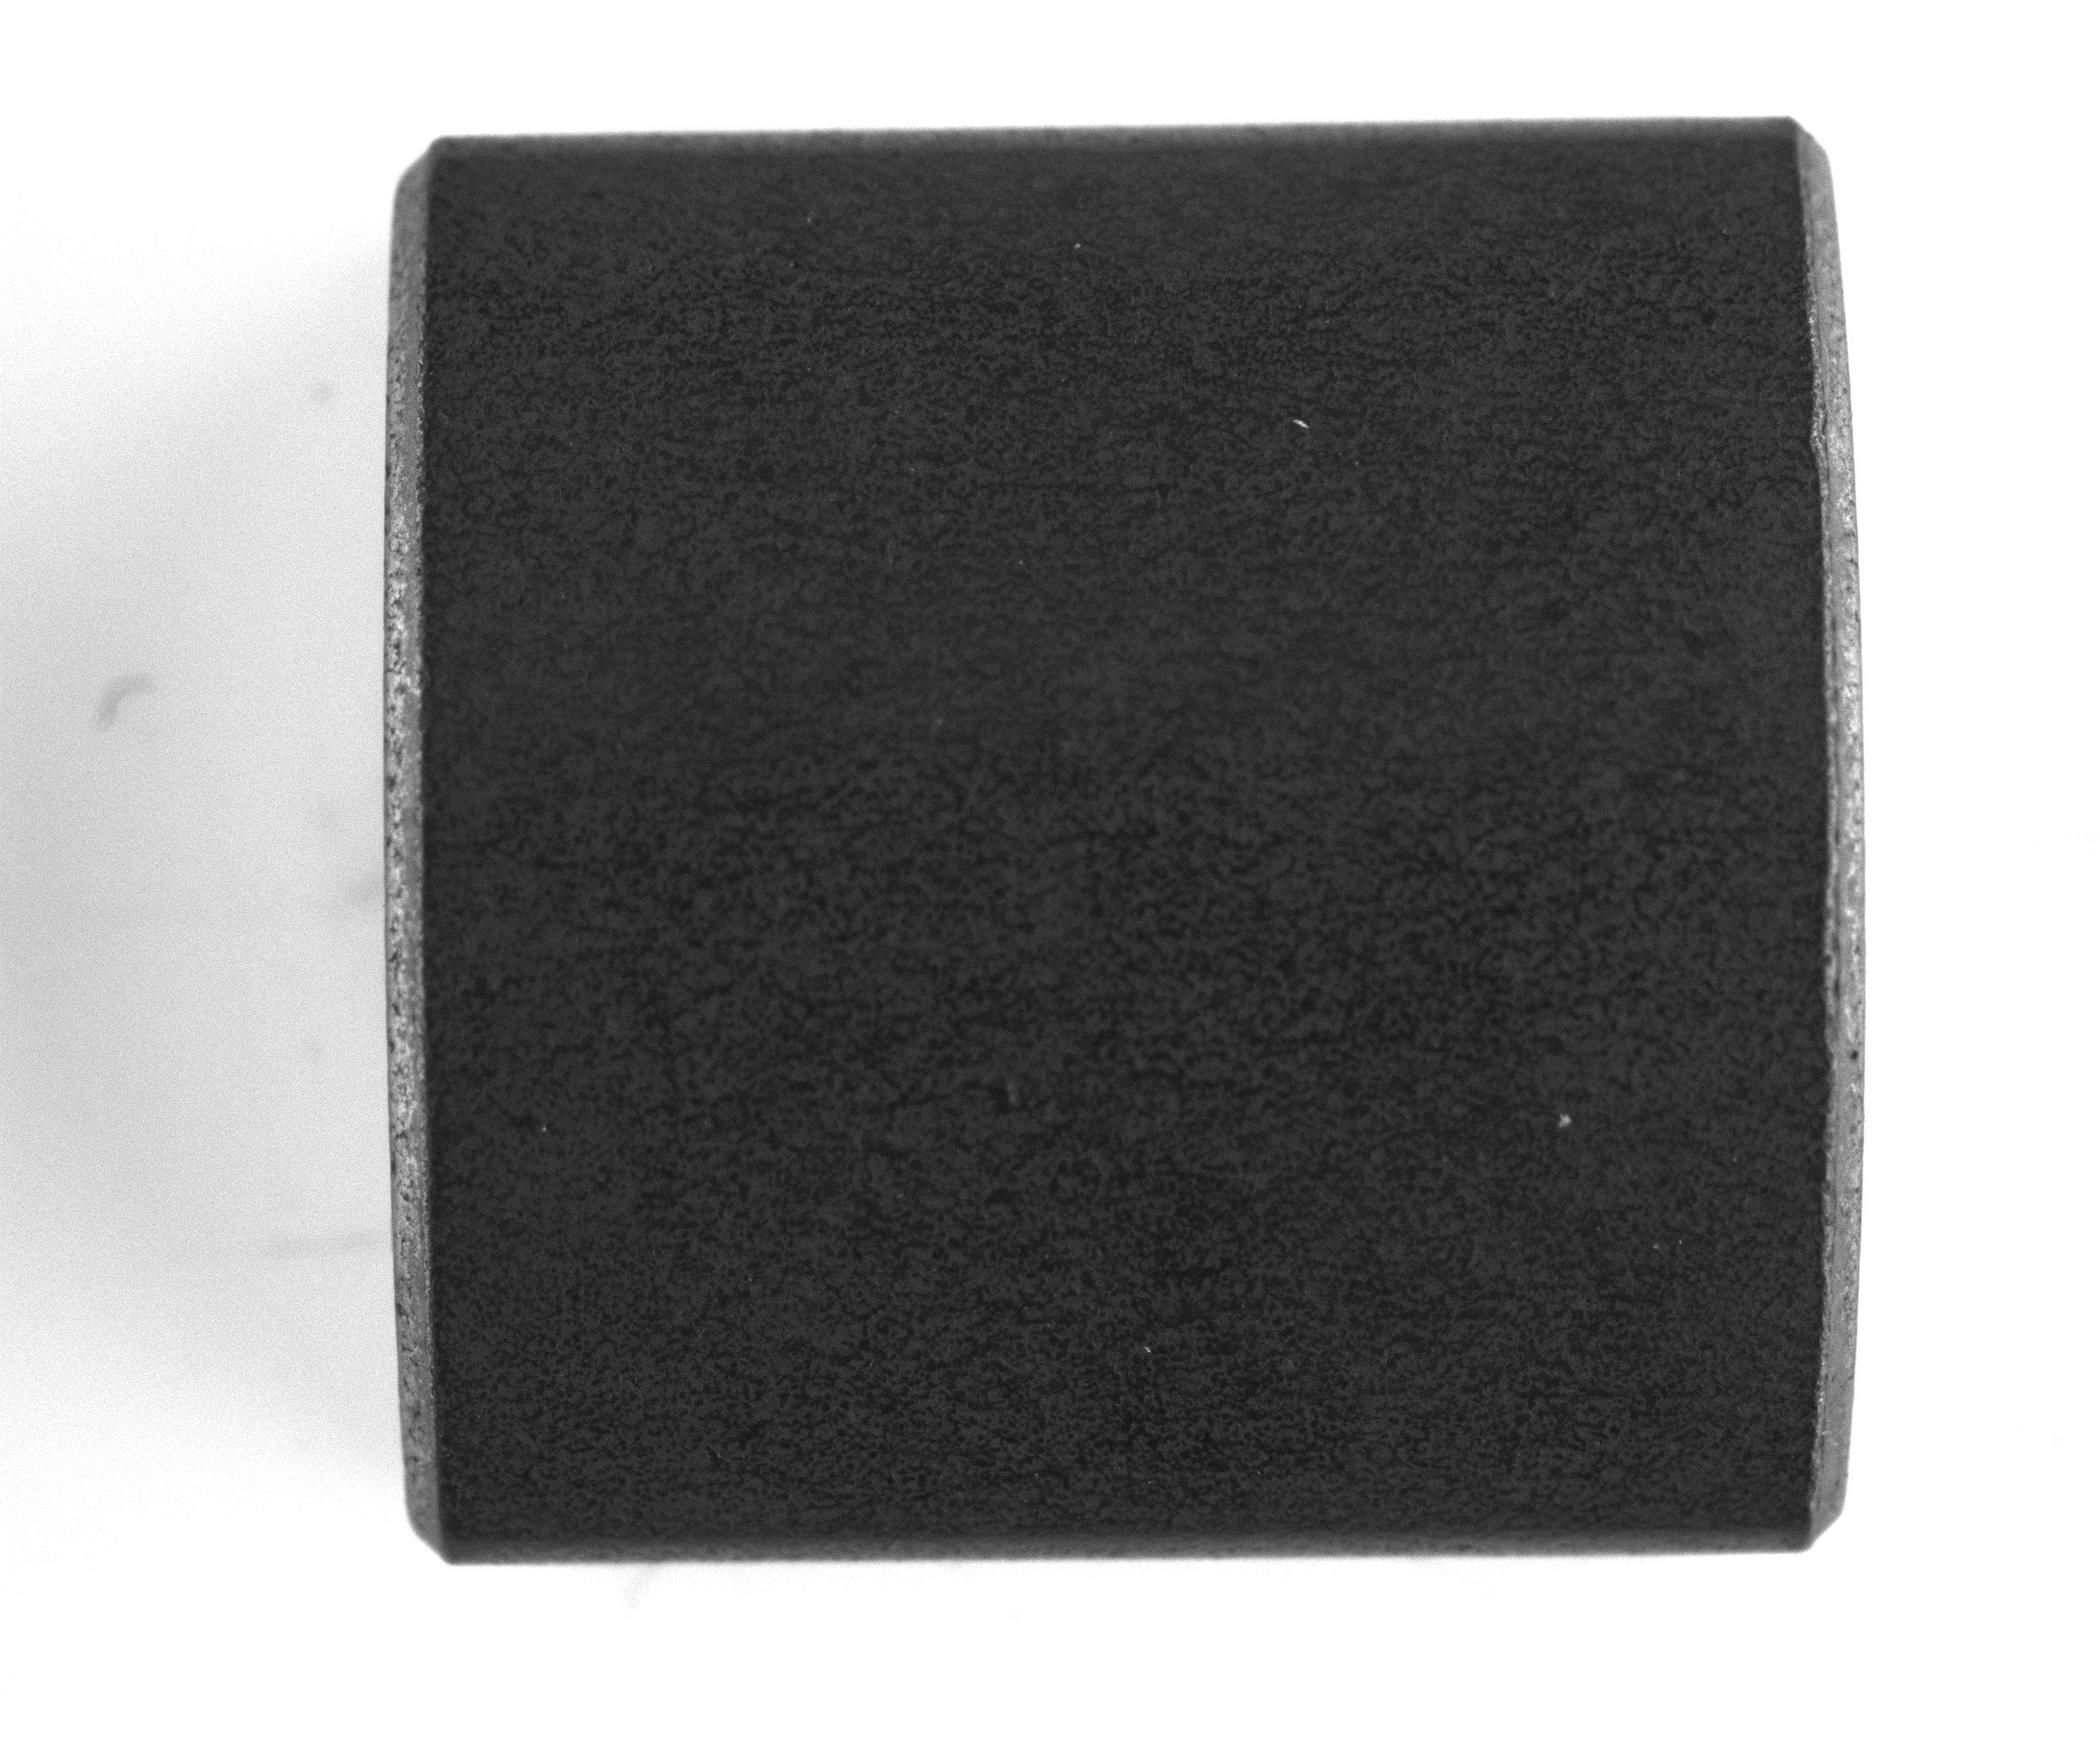
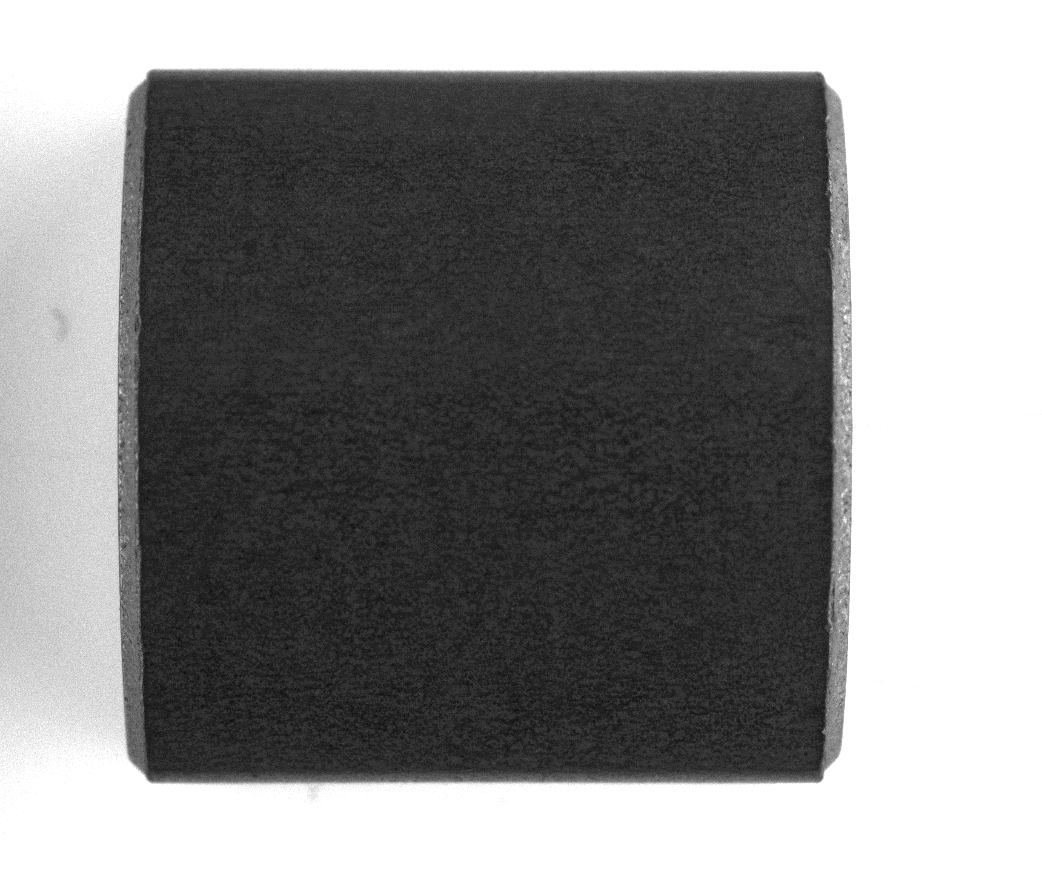
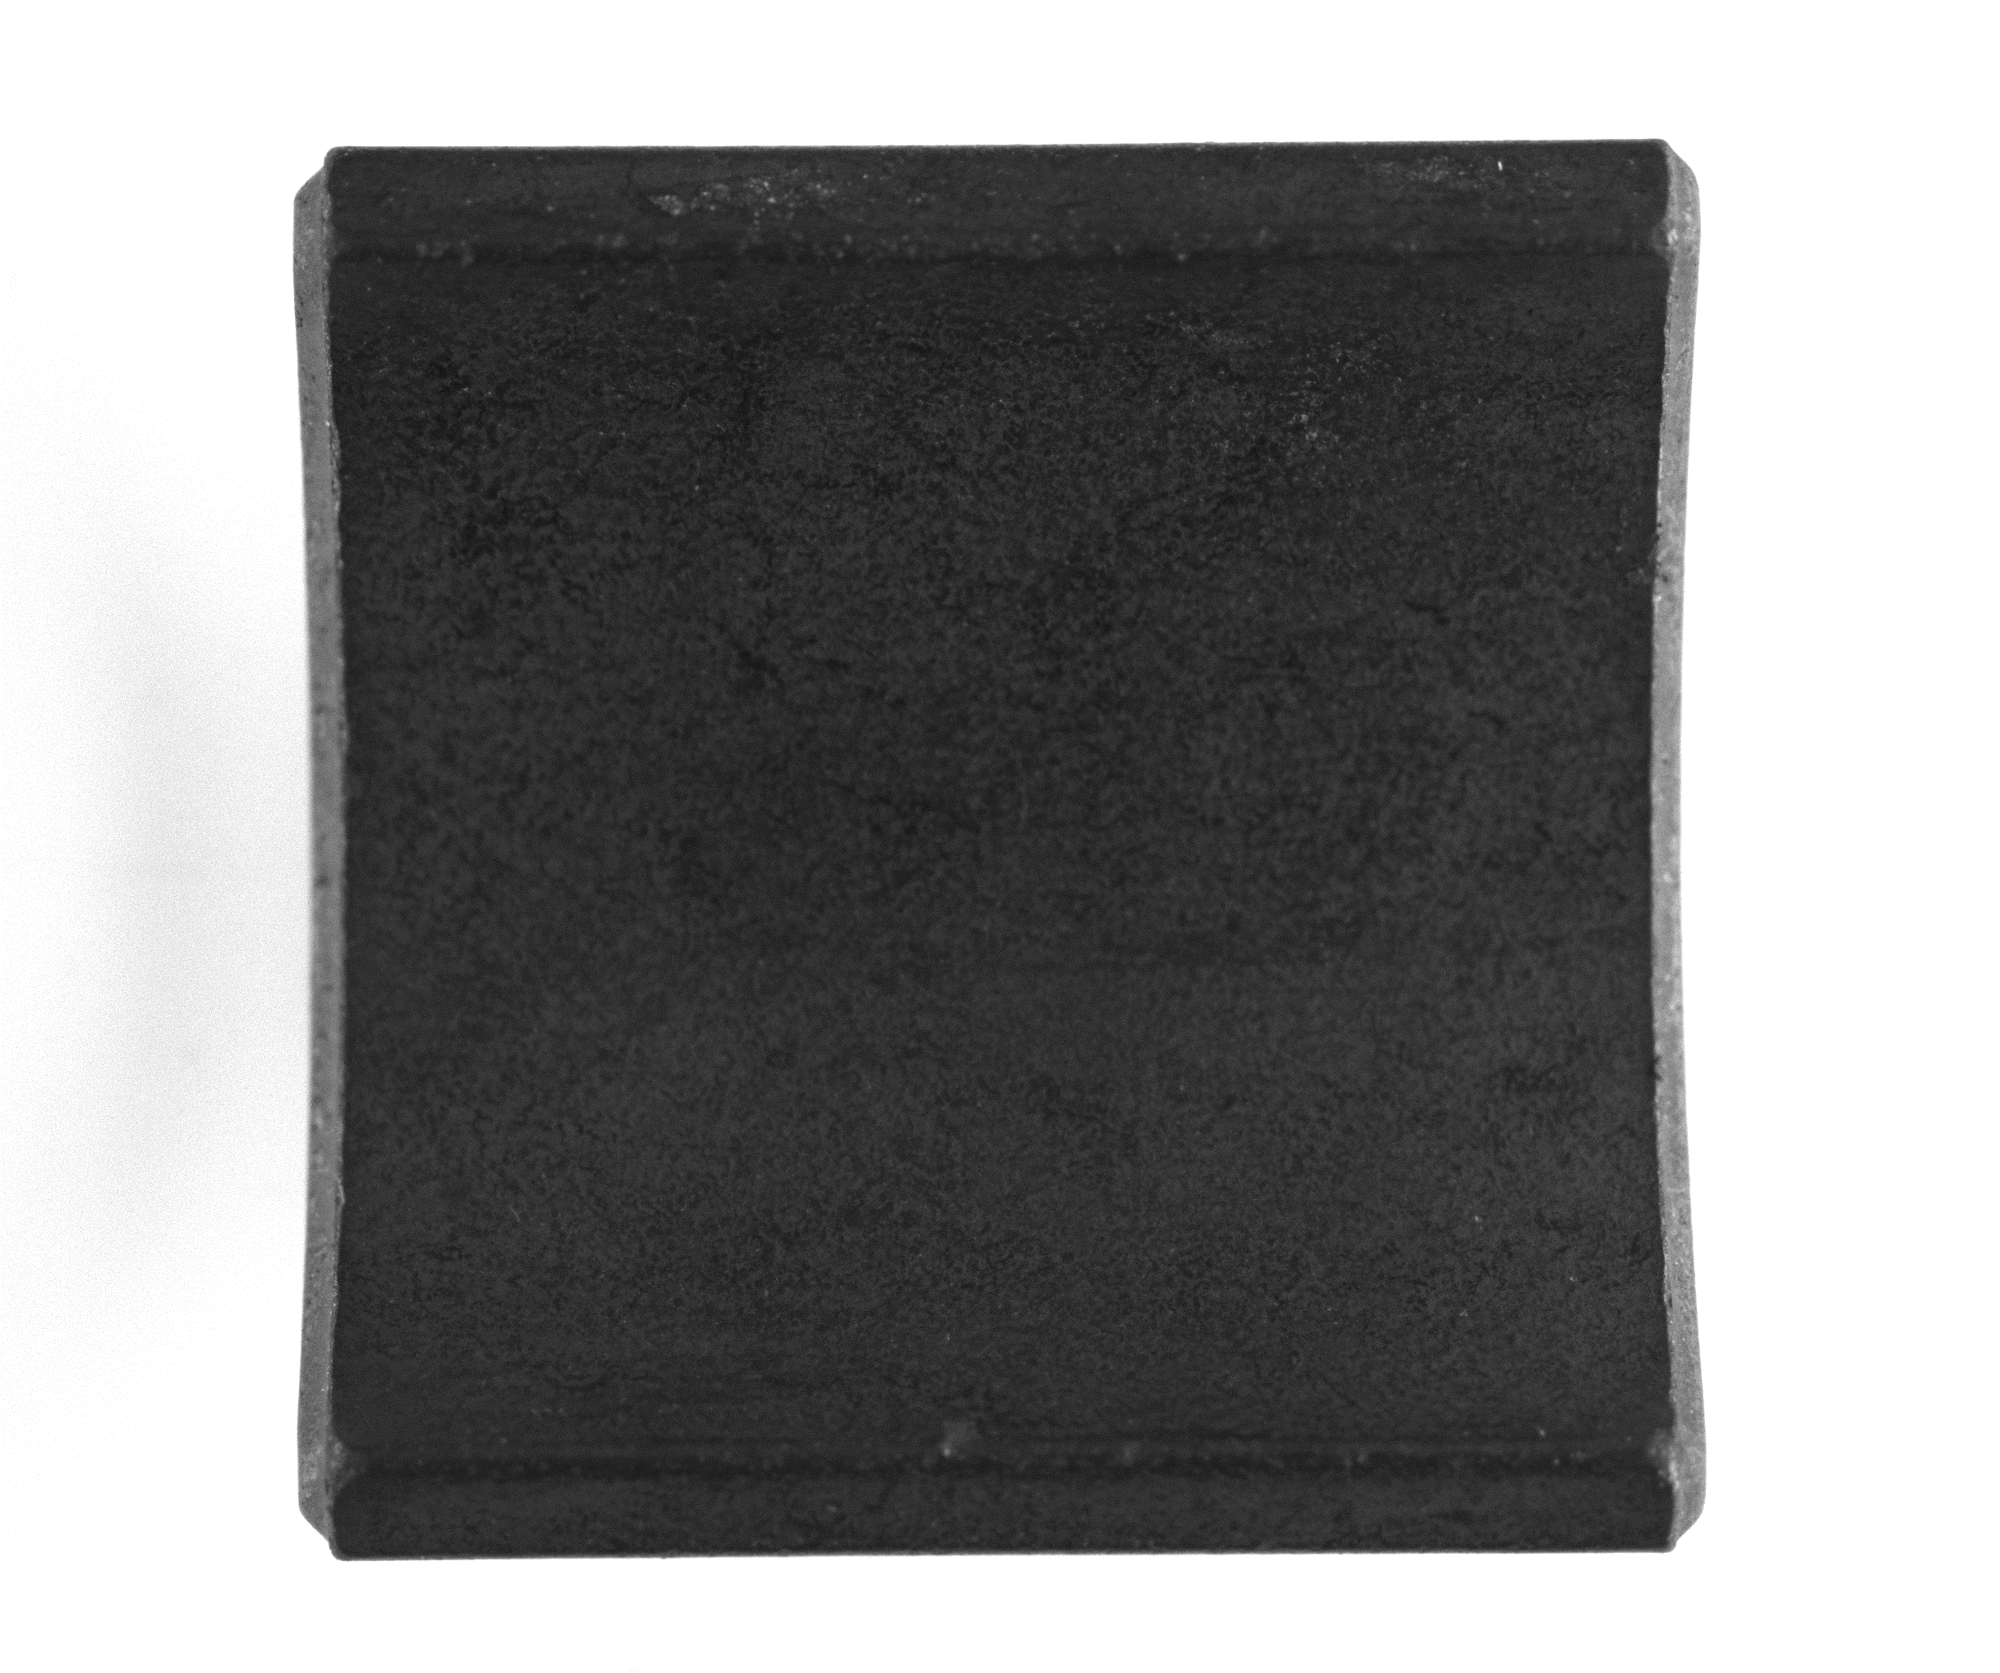

Take 300 photographs Train 92 good samples for outside 100 good samples for inside
Good sample outside
Good sample inside

Slide 16
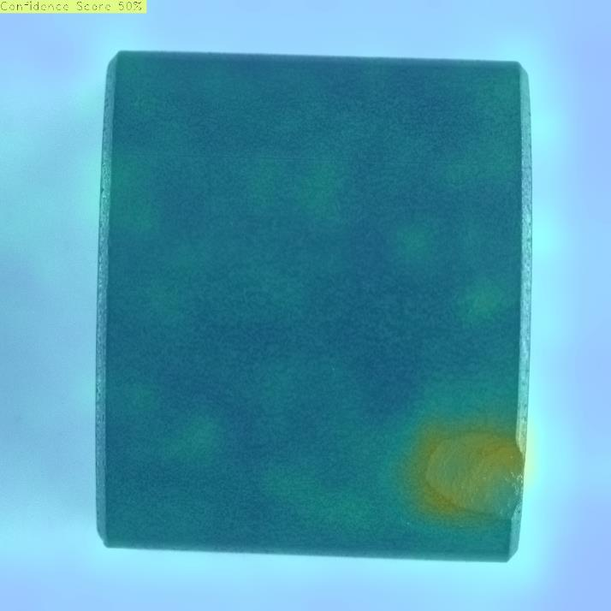
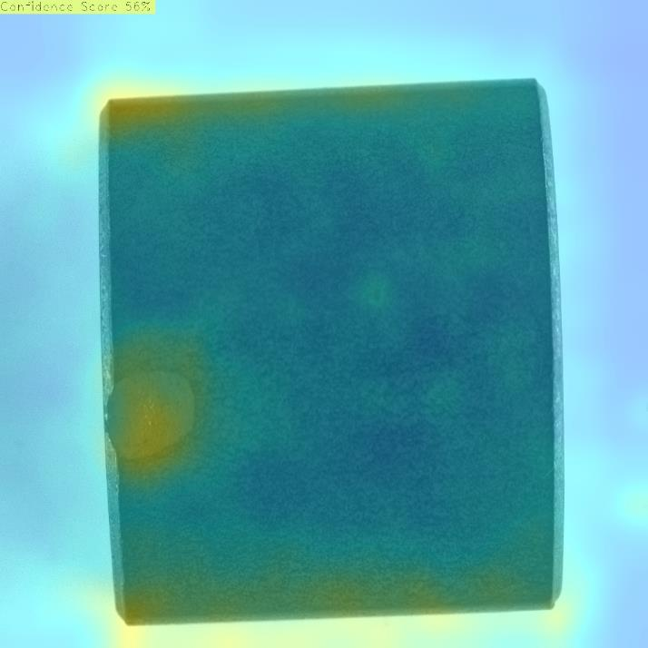
However I get
Outside

Slide 17
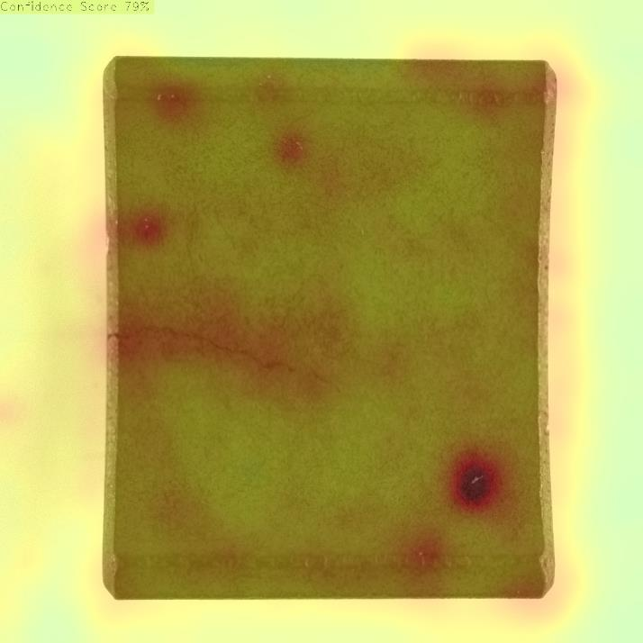
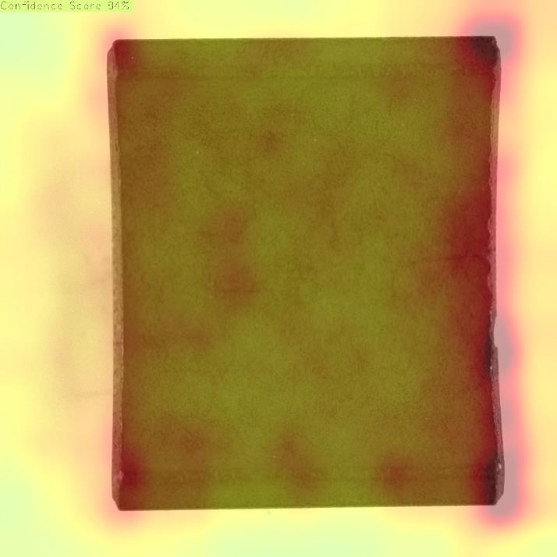
Inside crack

Slide 18
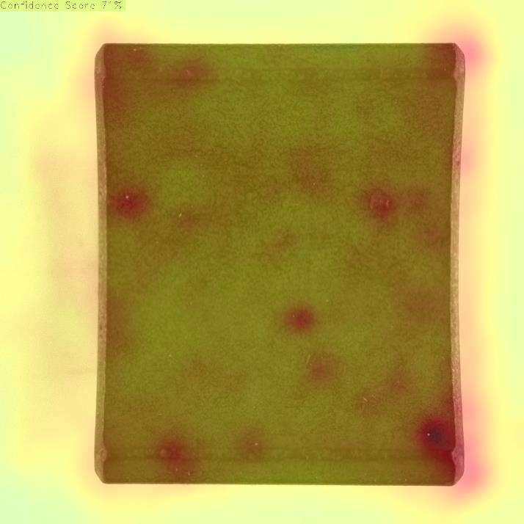
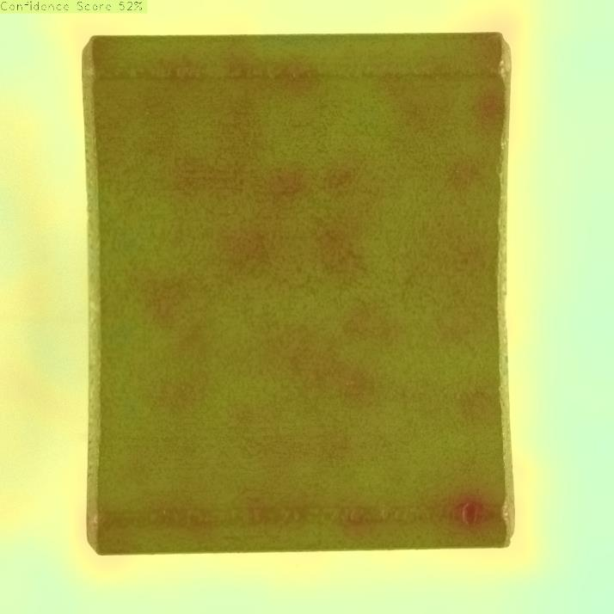
Inside hole

Slide 19
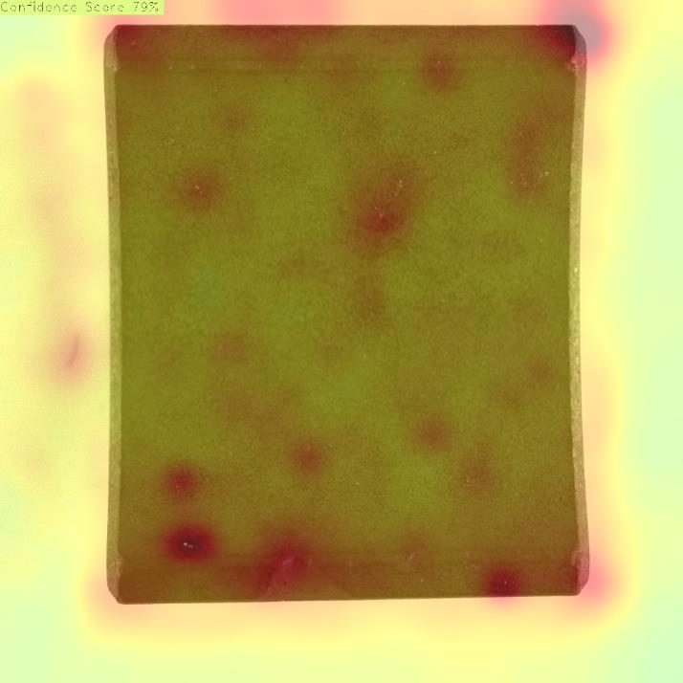
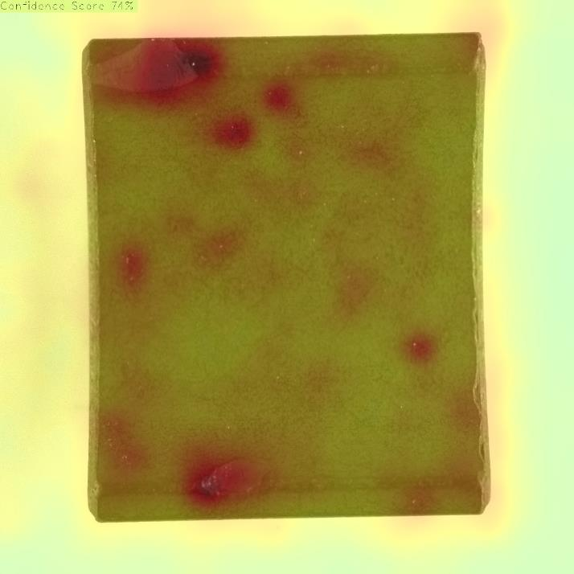
inside missing corner

Slide 20
Finally, I gave up. Back to traditional image processing

Slide 21
2022/3/10 Take 300 photographs again. After trying many methods, I need to HSV and B&W threshold. Other edge detection useless in this case.
HSV: Hue, Saturation, Value
B&W: Black and White
BMW: Bavaria Motors Works

Slide 22
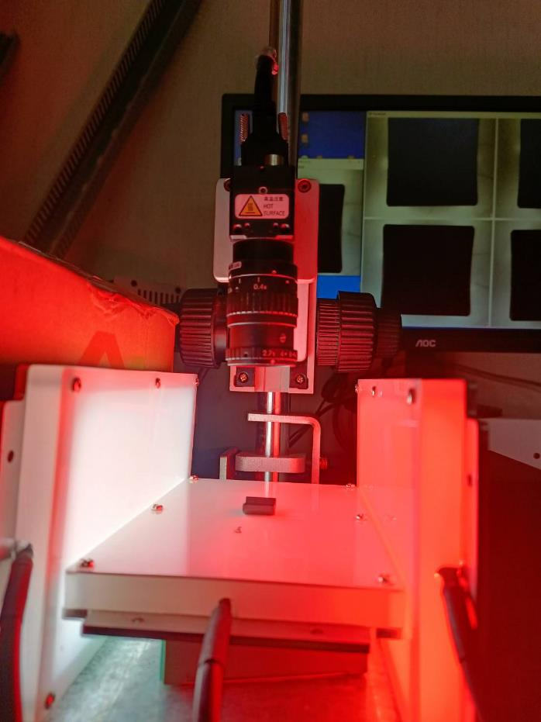
Environment

Slide 23
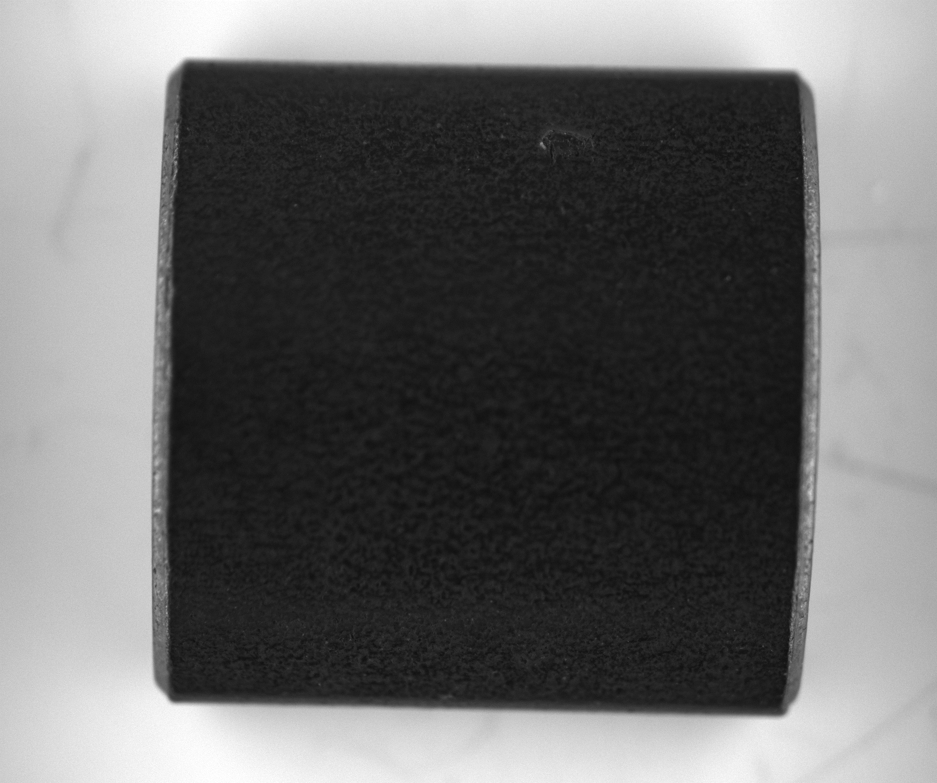
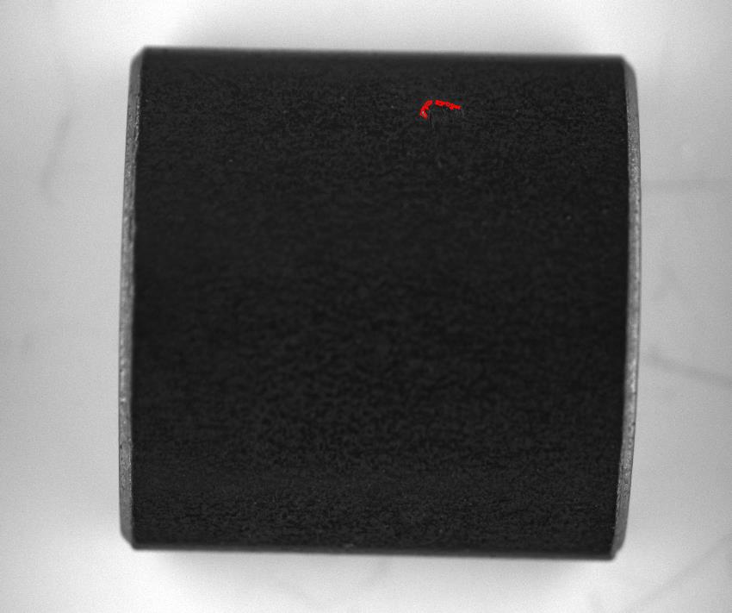
Outside use HSV
NO1.1

Slide 24
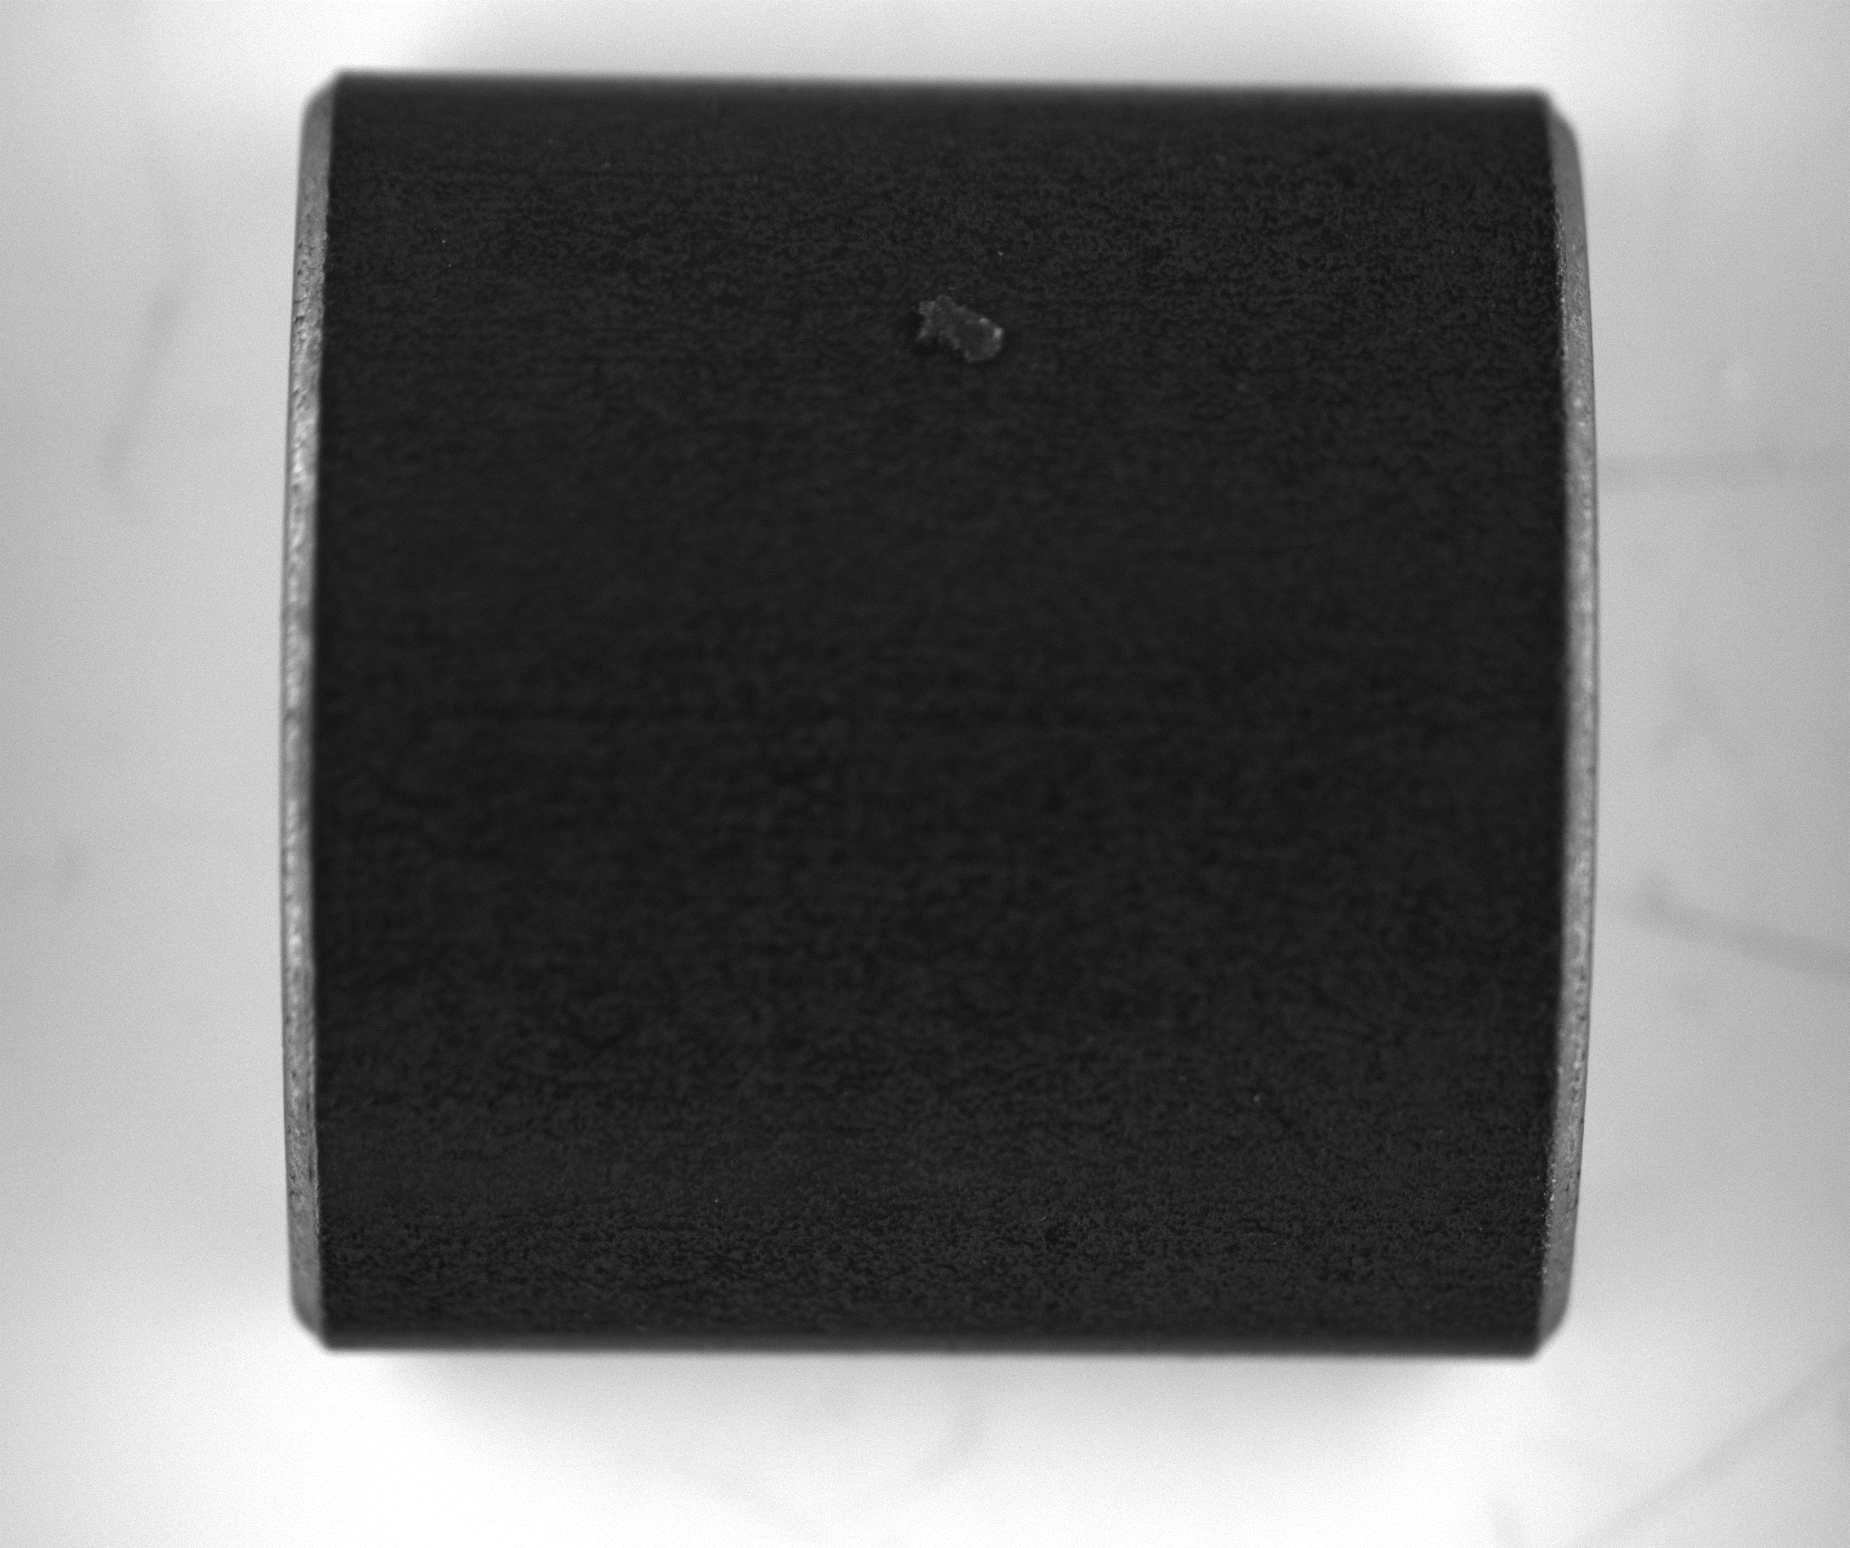
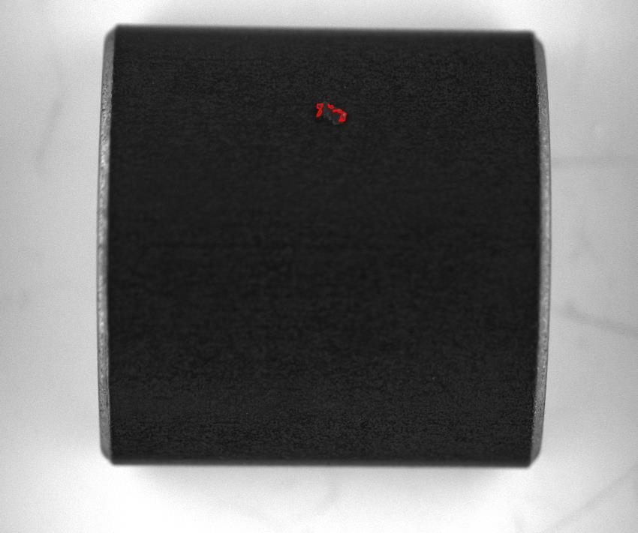
NO1.2

Slide 25
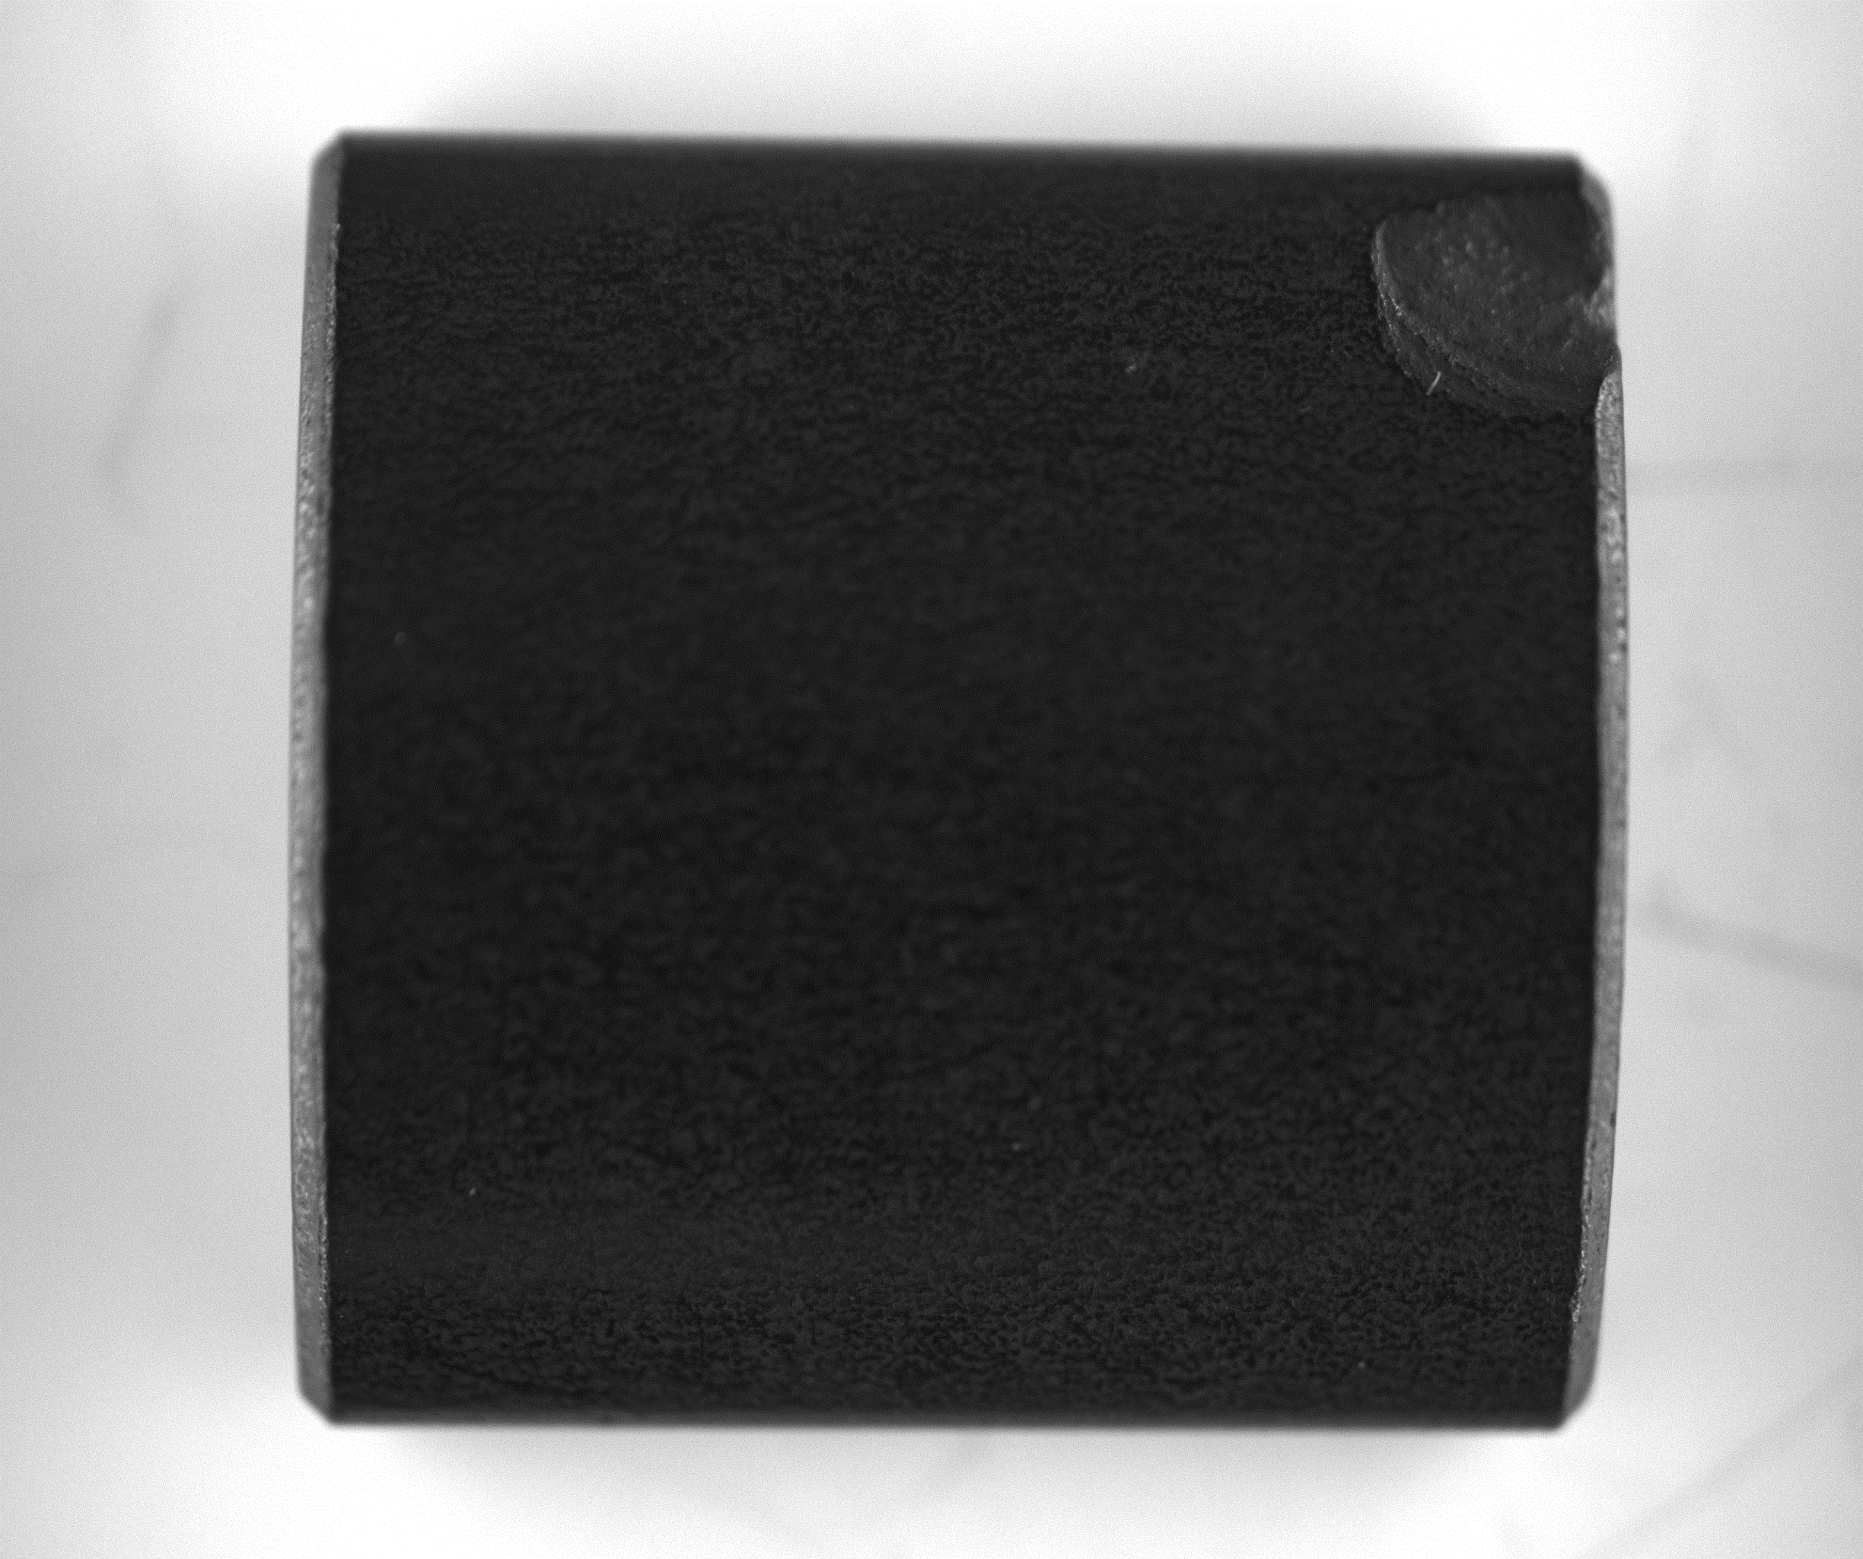
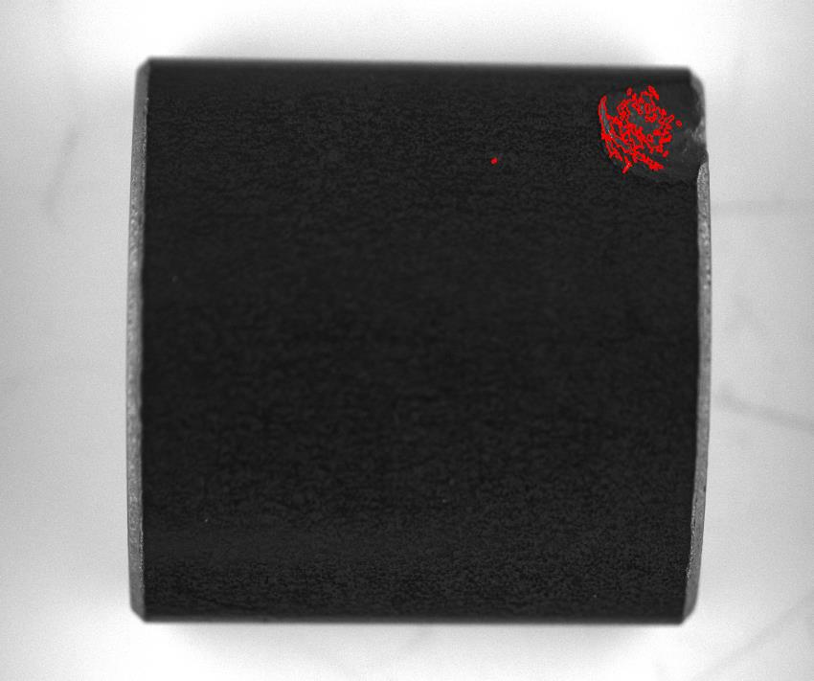
NO1.4

Slide 26
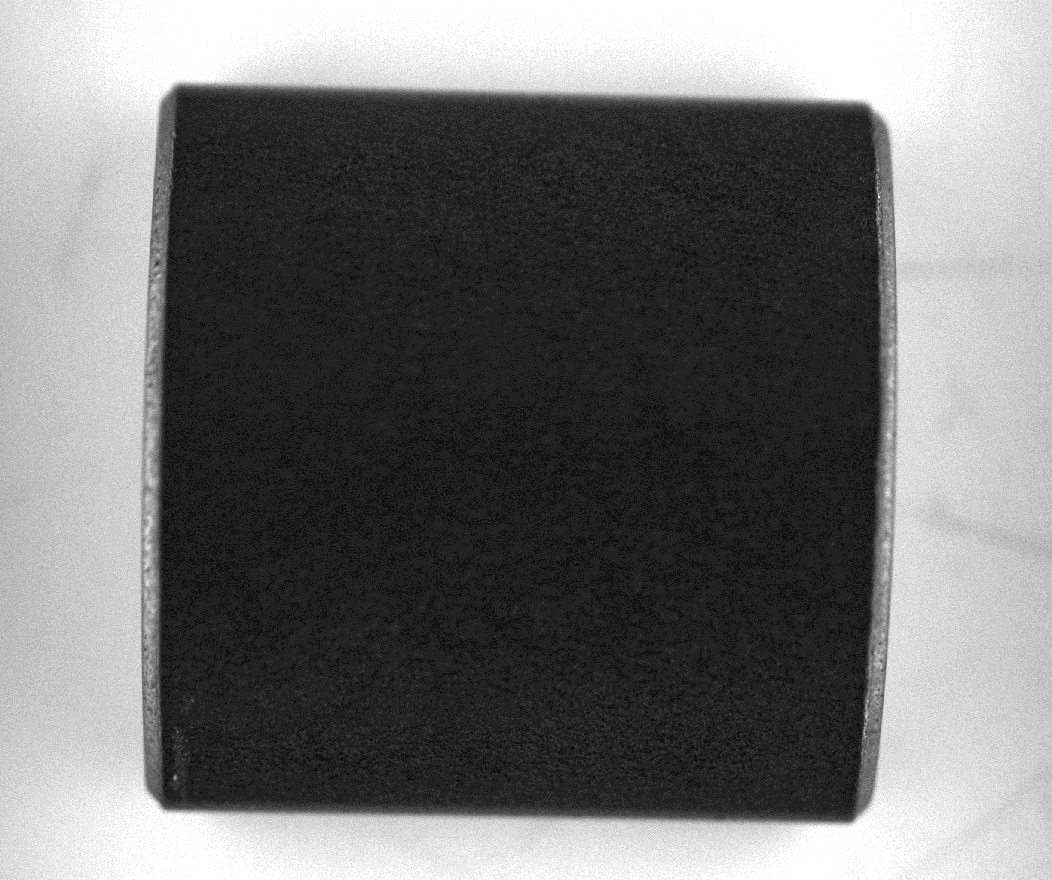
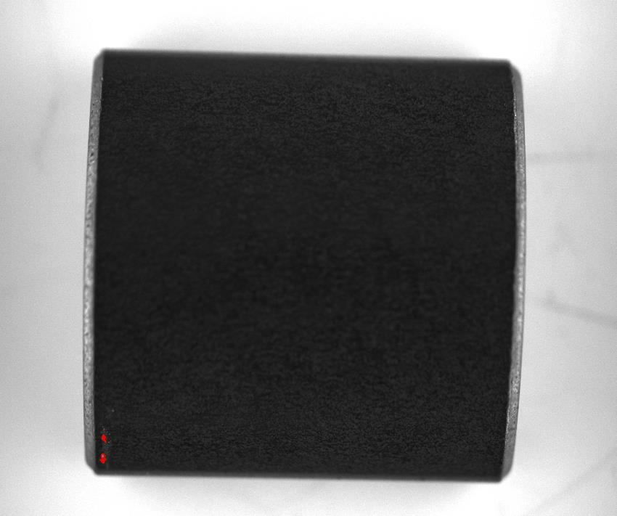
Dark velvet
NO1.11

Slide 27
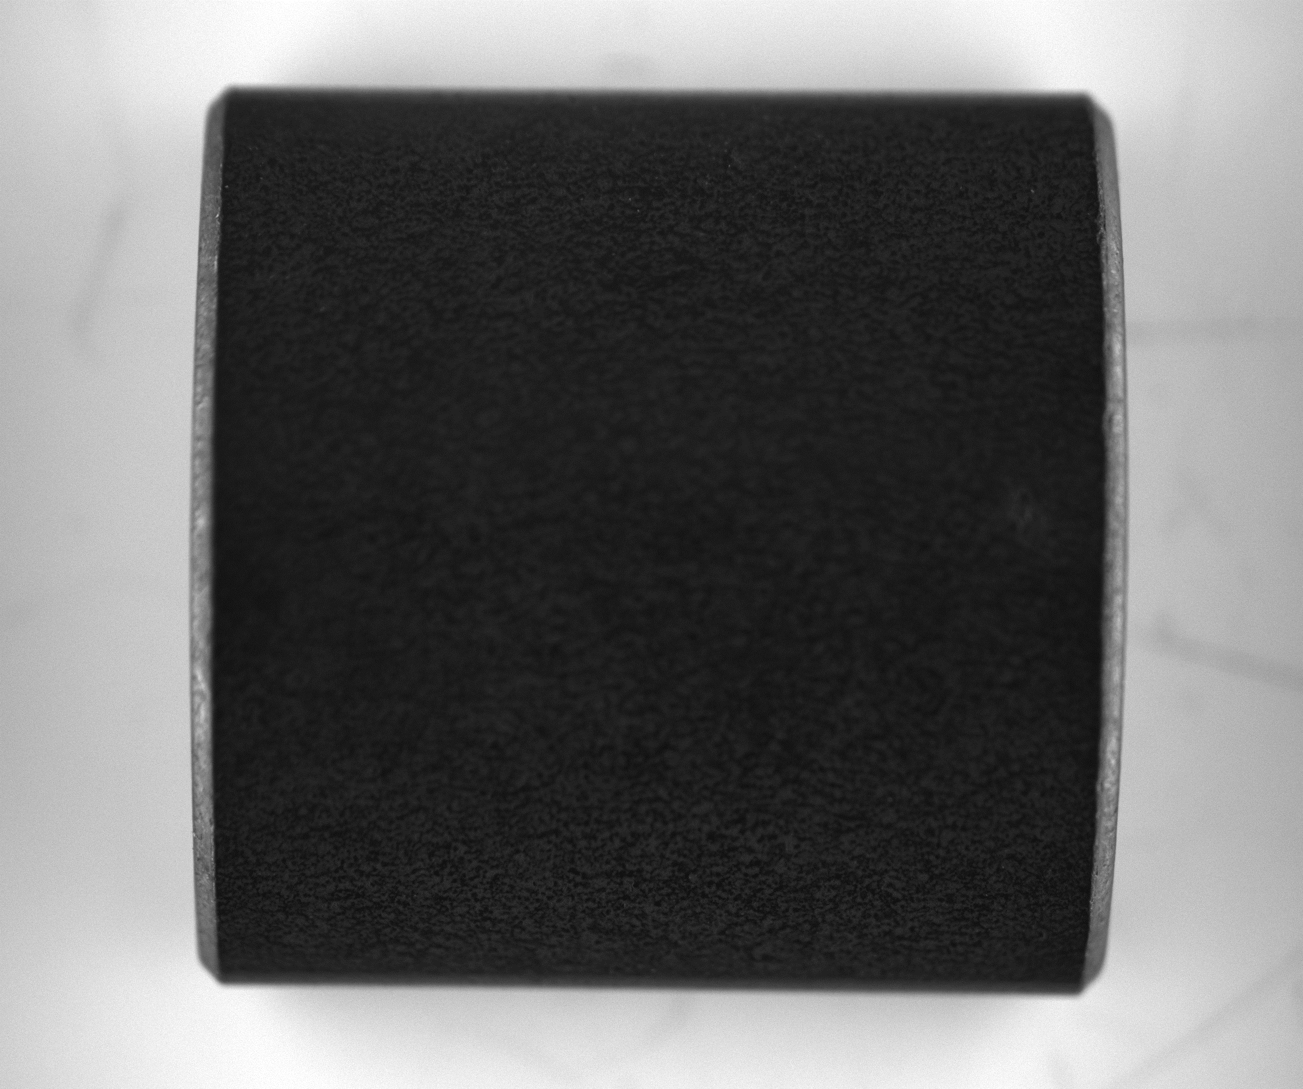

However, out of focus in 1.5
NO1.5

Slide 28
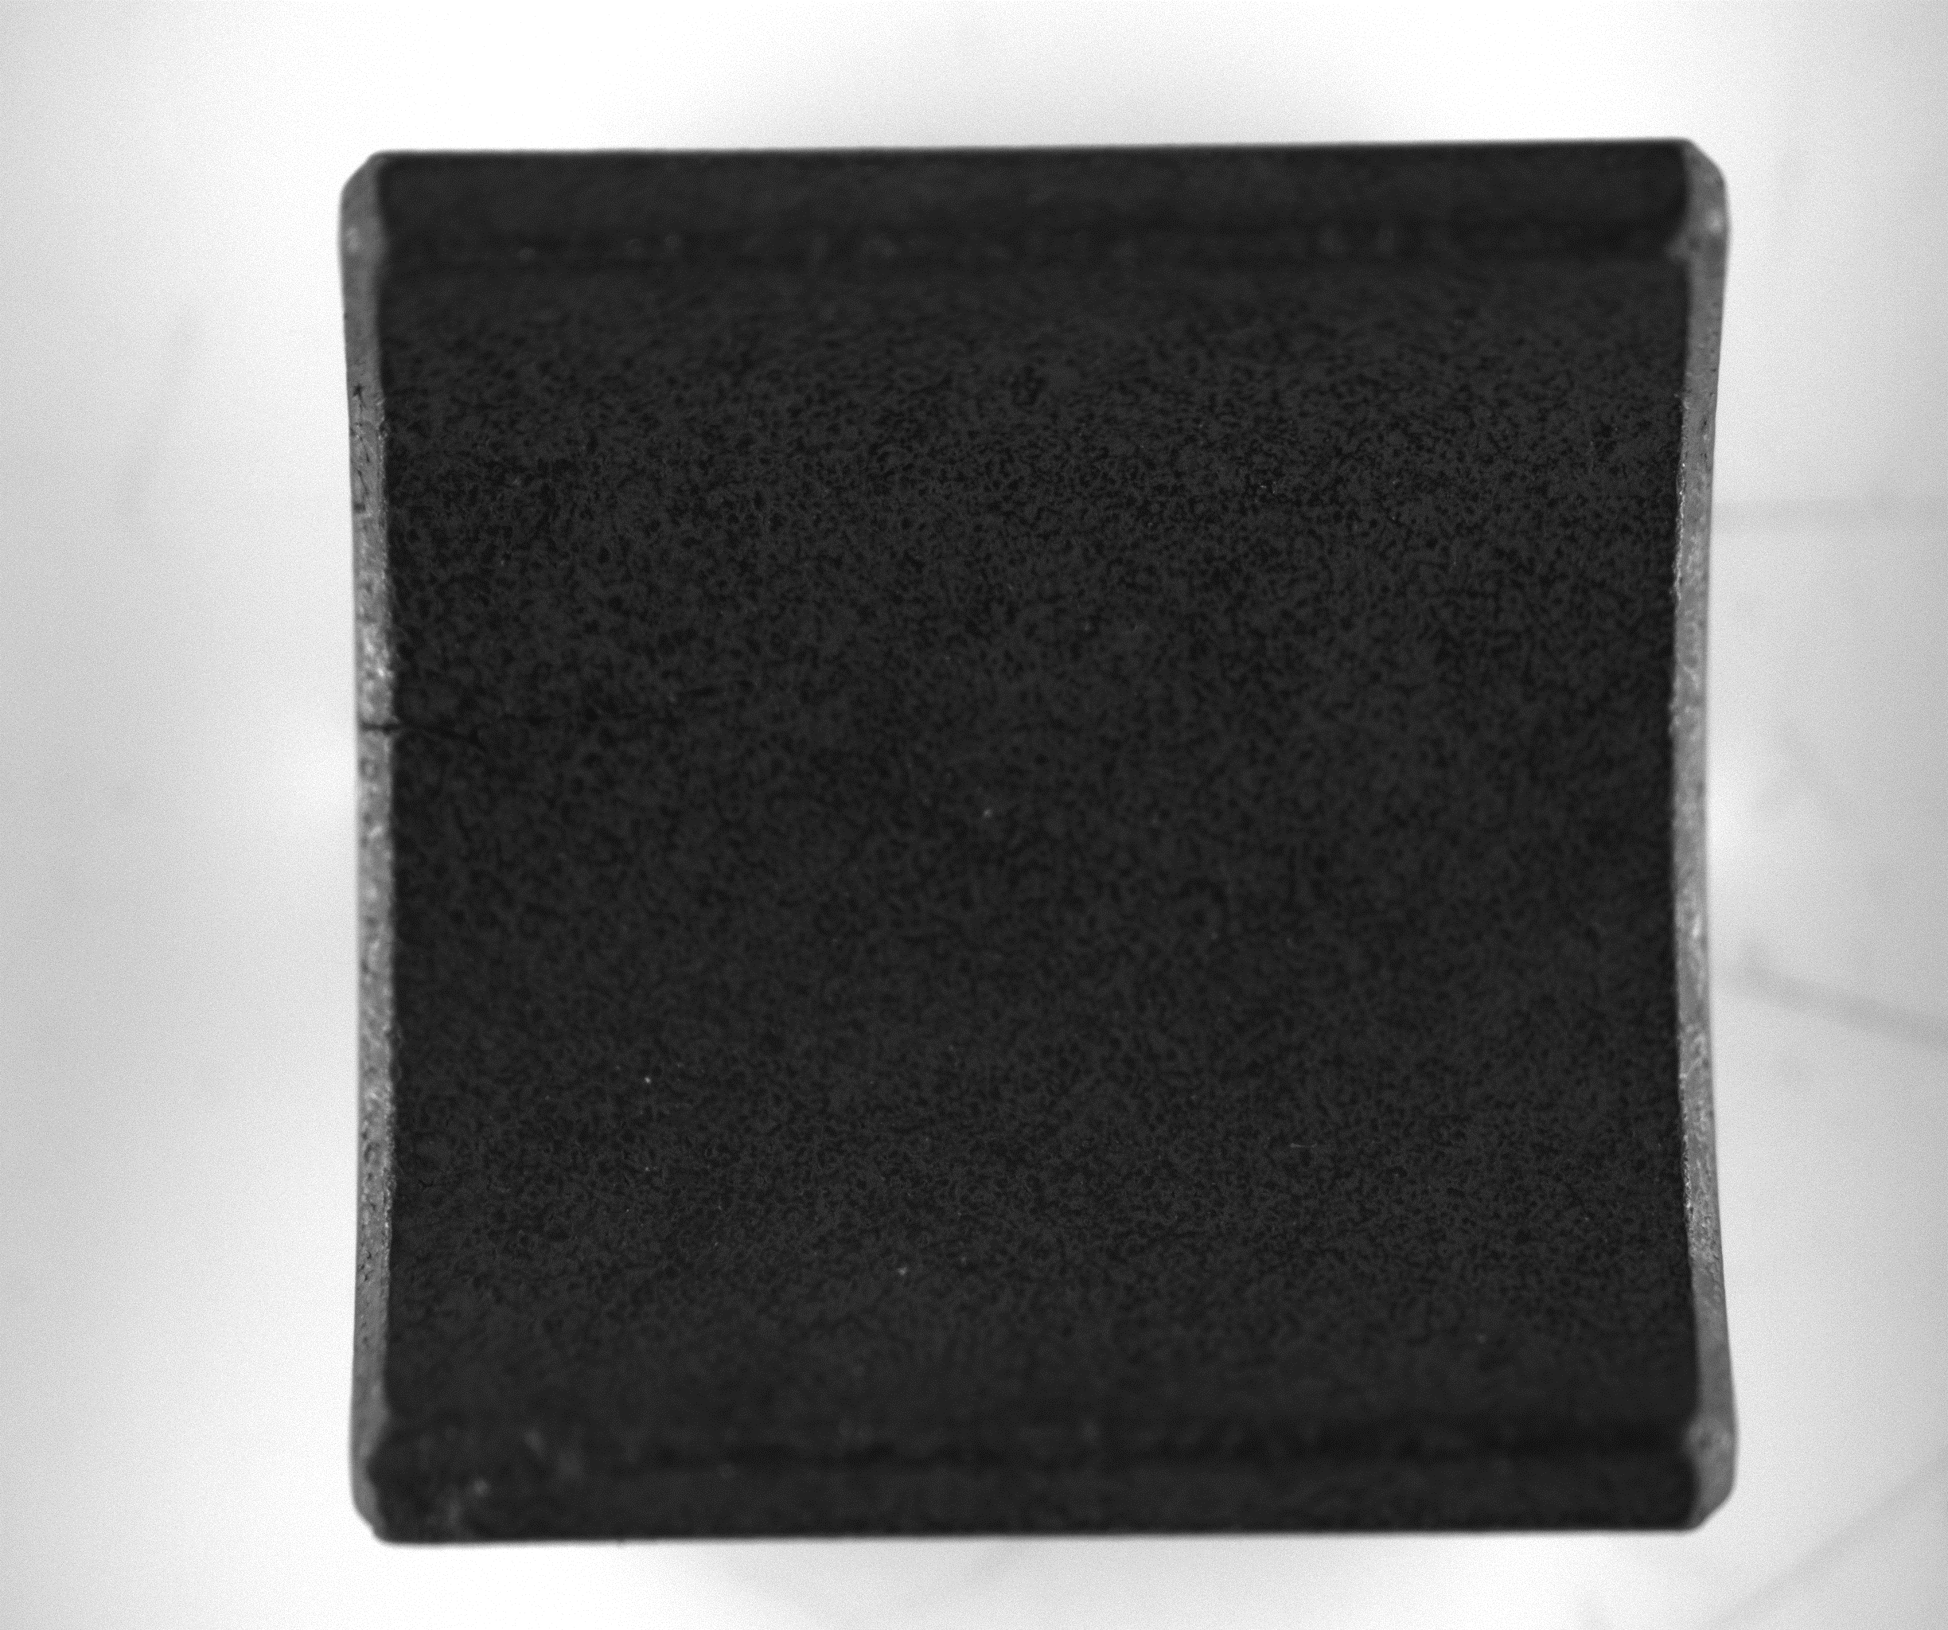
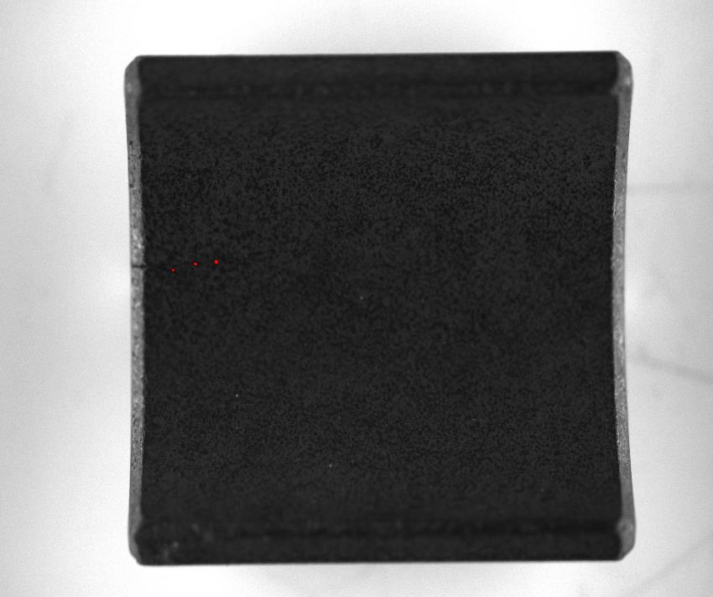
Inside crack Threshold -> Dilation and Erosion
NO4.2

Slide 29
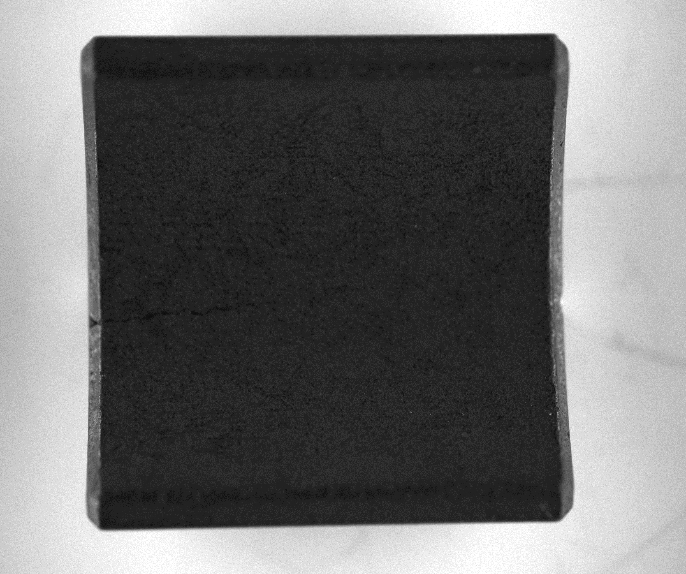
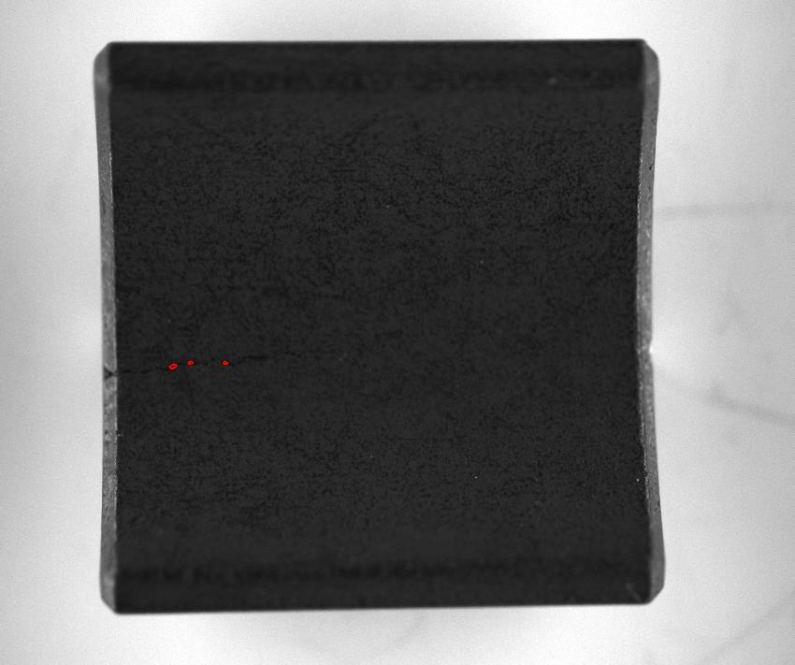
NO4.1

Slide 30
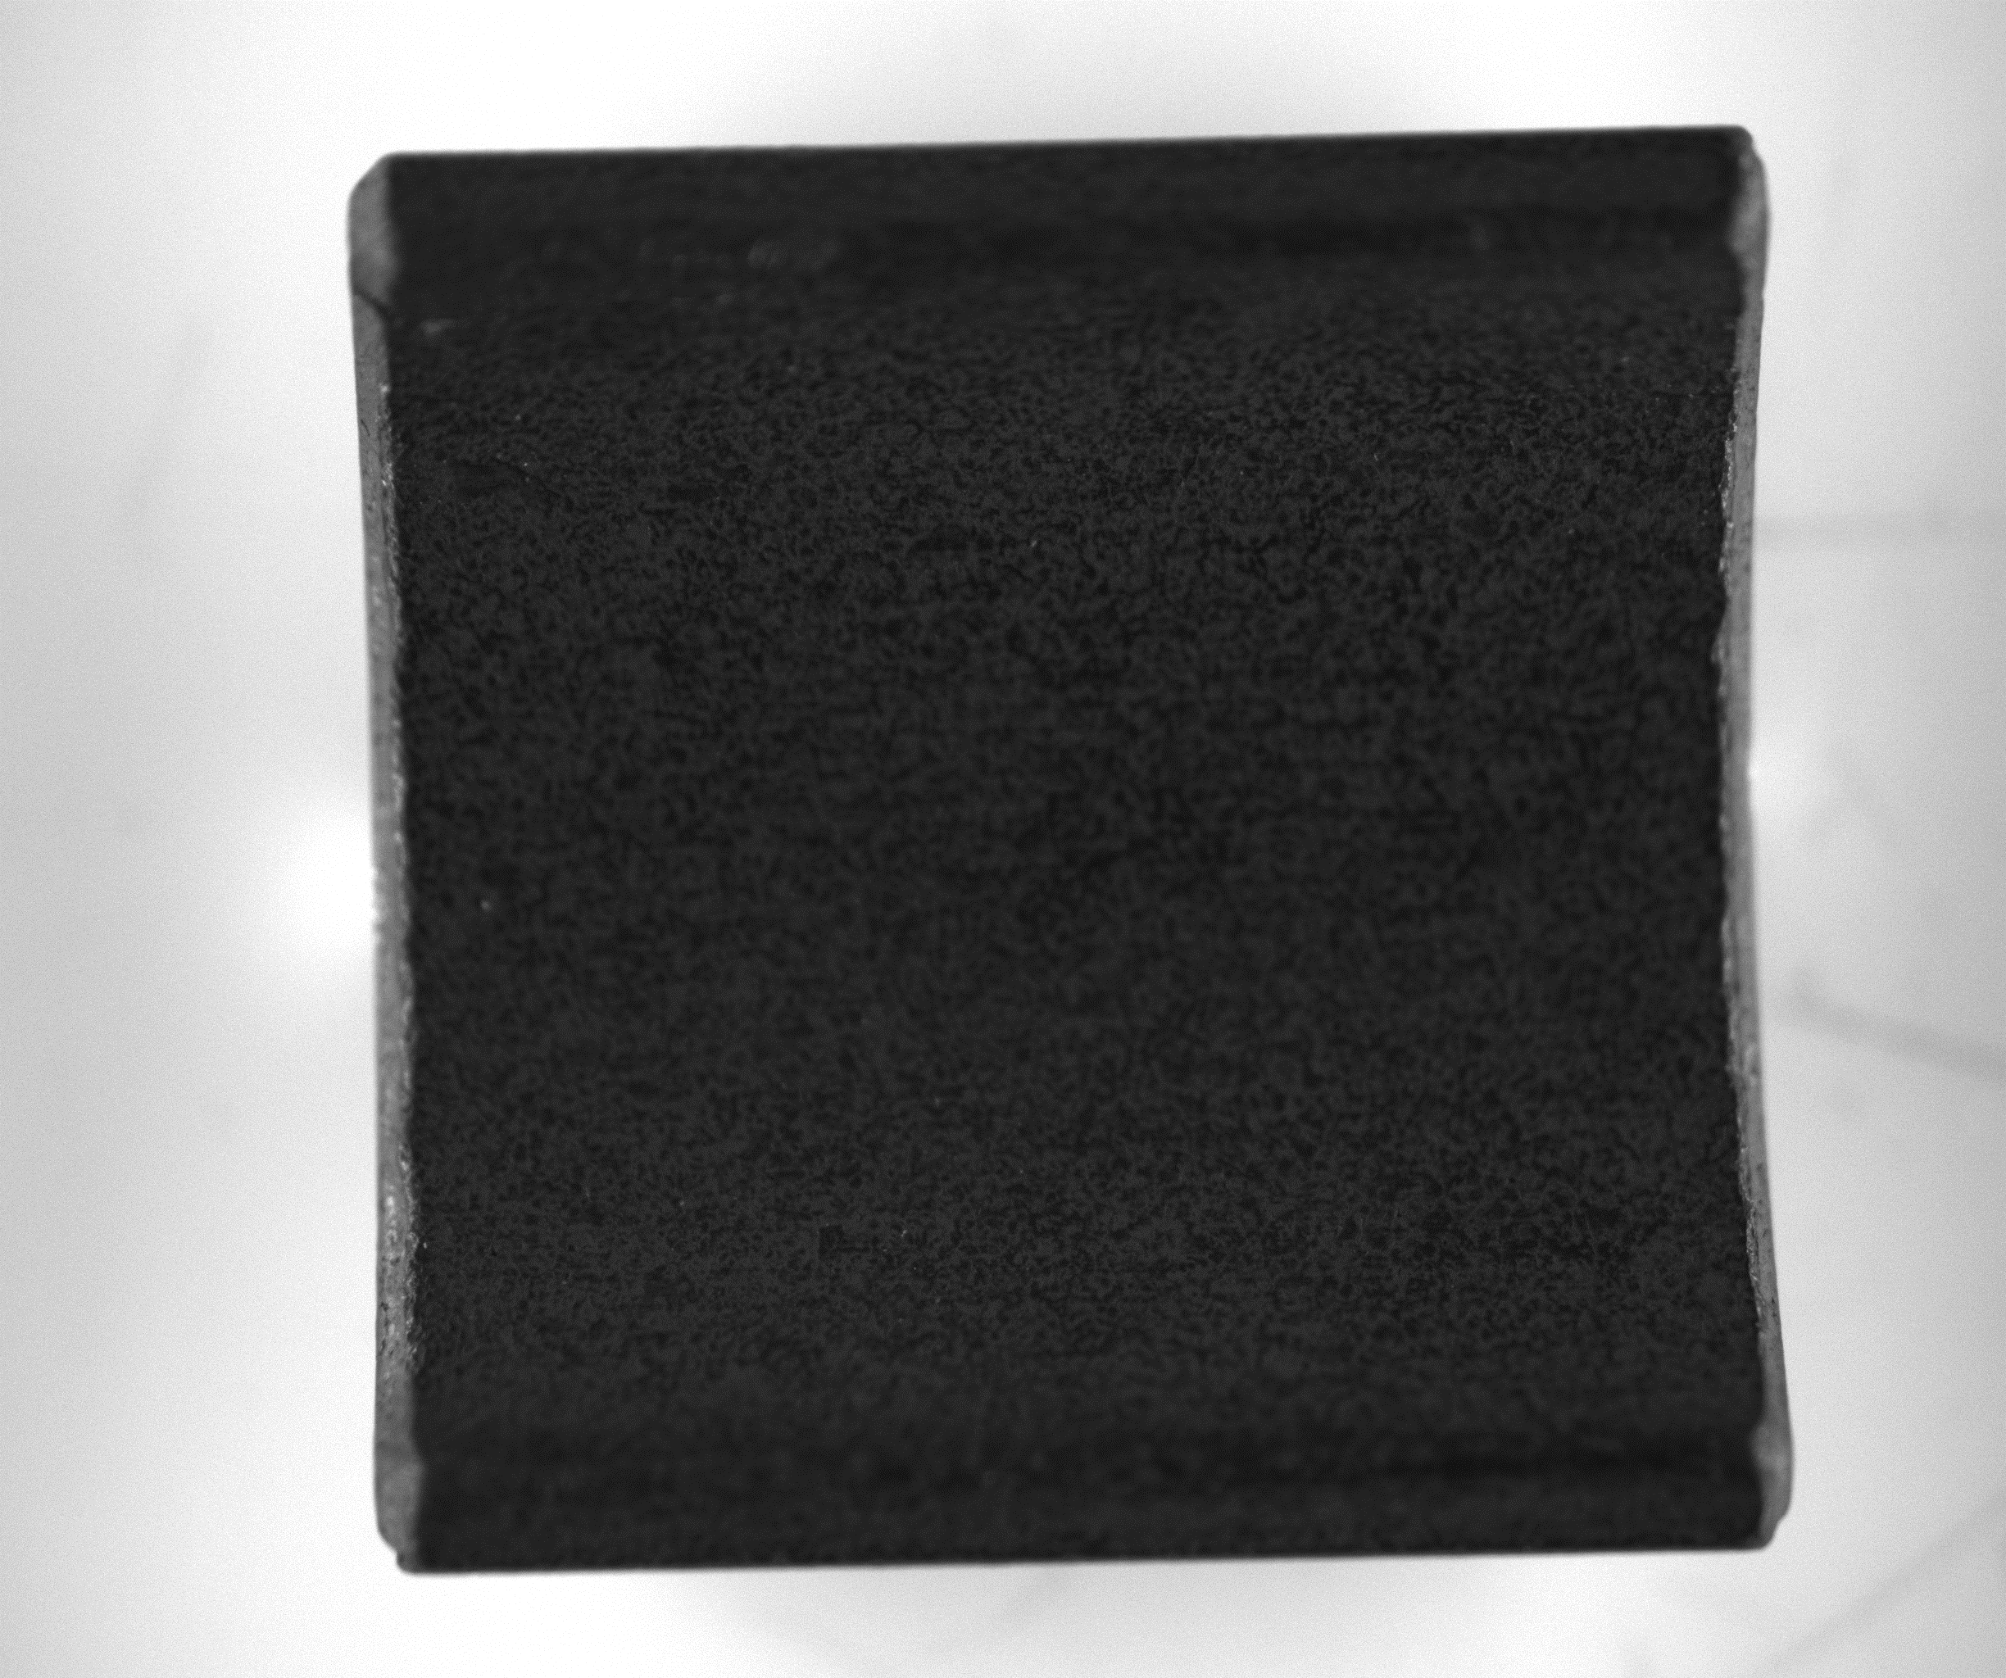
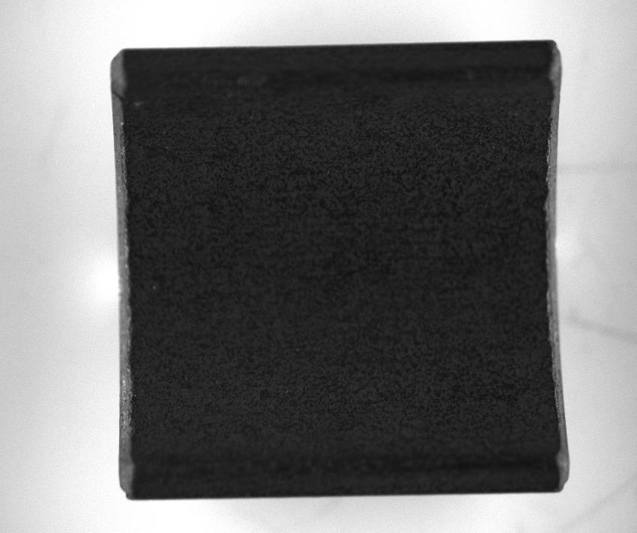
However, out of focus in 4.4, 4.5, 4.6, 4.8, 4.9, 4.10
NO4.4

Slide 31
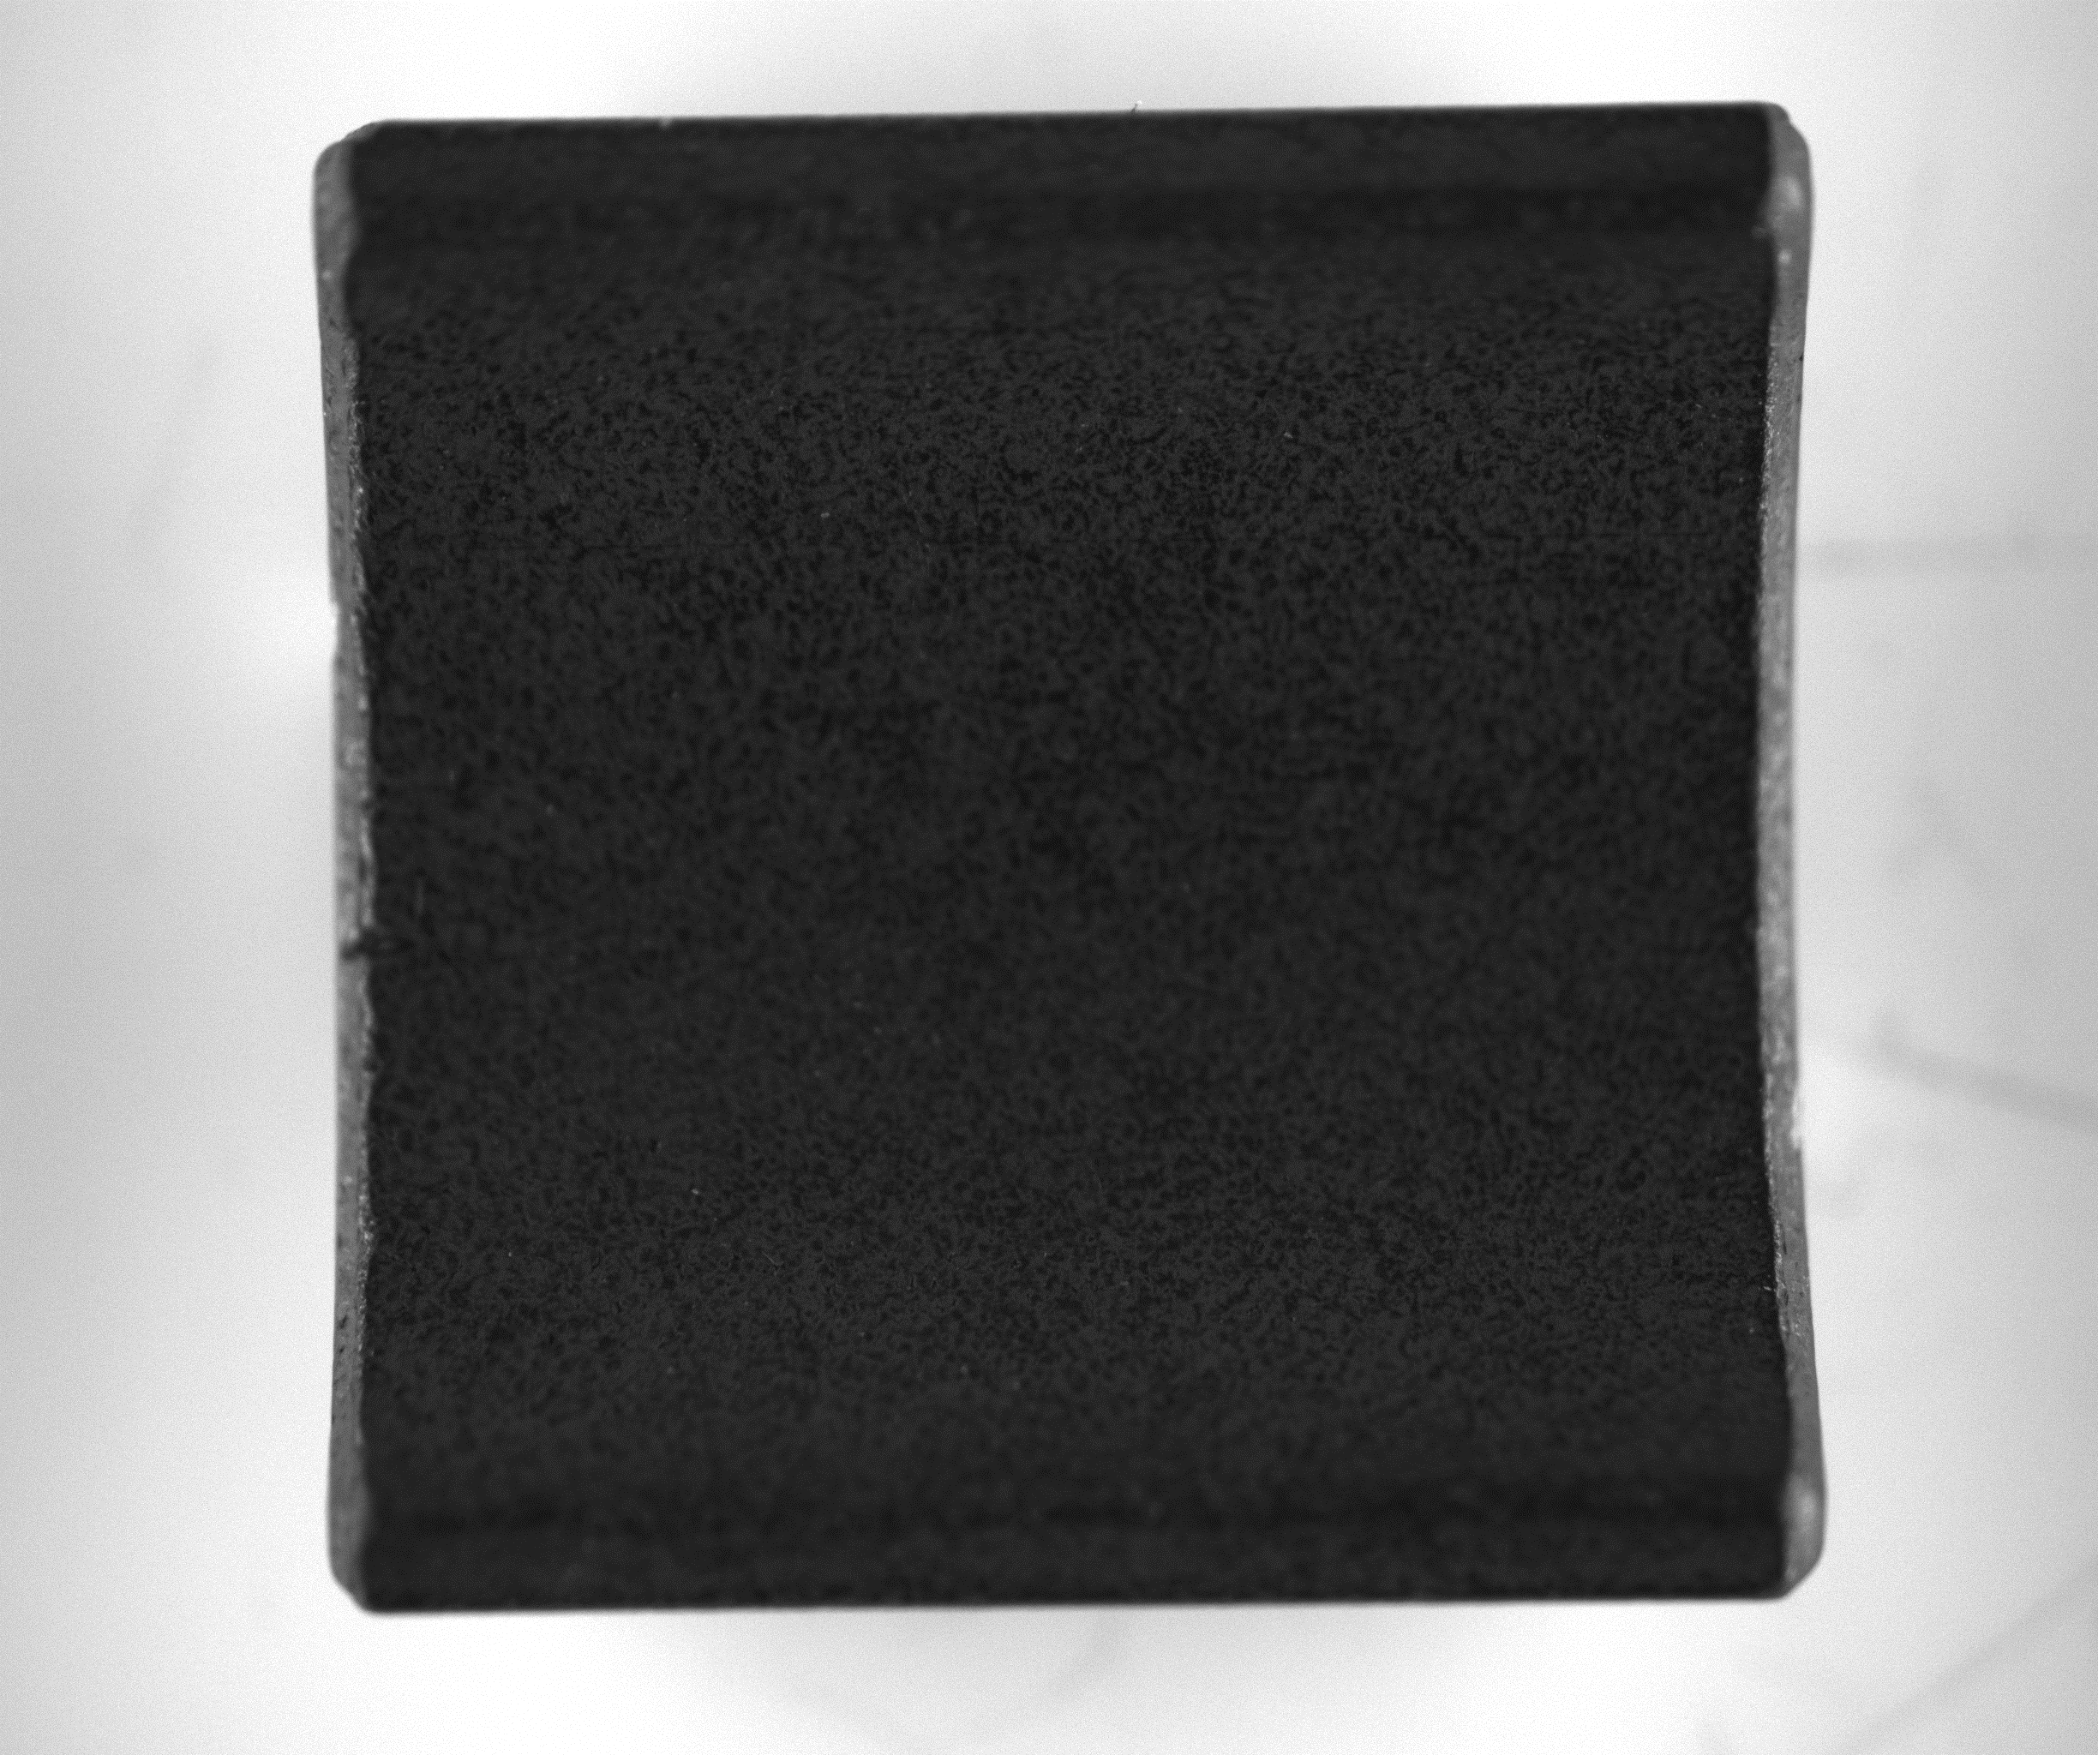
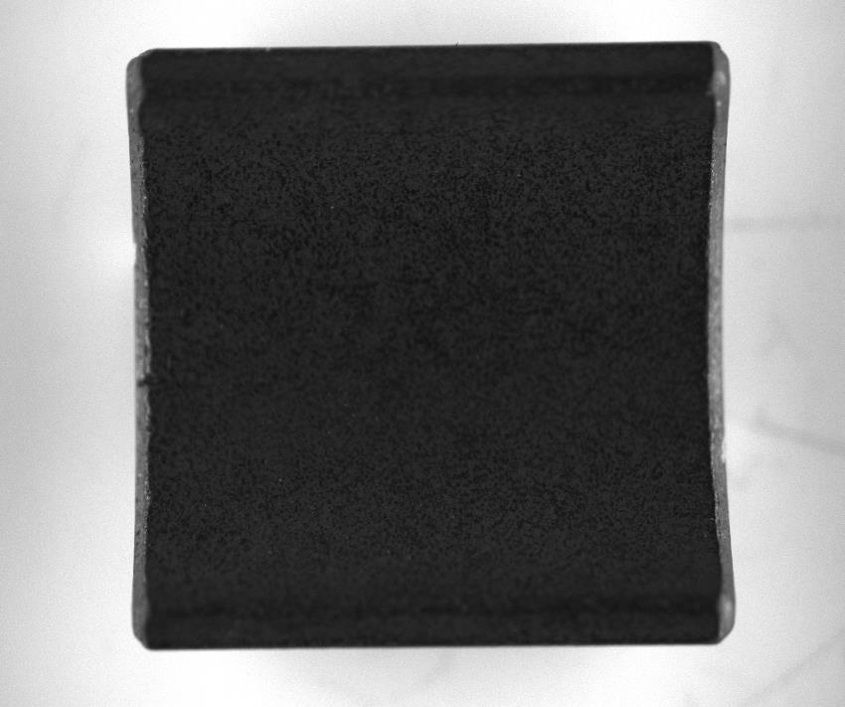
NO4.5

Slide 32


Inside hole Use threshold
NO3.1

Slide 33


NO3.2

Slide 34


NO3.3

Slide 35


However, 3.6 too shallow. Use 2 thresholds to conquer 3.6, and new threshold does not affect other samples.
NO3.6

Slide 36


Inside hole Use HSV -> Dilation and Erosion There two types of defects
NO2.1

Slide 37


NO2.2

Slide 38

Use HSV:
NO2.1

Slide 39

Use dilation and erosion:
NO2.1

Slide 40


NO2.3

Slide 41
However, it is still not enough With 79 defect samples, I only find 72. The boss said the success rate should be at least 96%. Finally, the case of blood glucose test strips give me inspiration. Use two stations!

Slide 42


NO1.5

Slide 43


NO4.4

Slide 44


NO4.5

Slide 45
Finally, all defects are found. And the normal samples false alarm.

Slide 46


Outside
NO5.2

Slide 47


Outside
NO5.2

Slide 48
Outside
NO5.4

Slide 49


Outside
NO5.7

Slide 50


Inside
NO6.1

Slide 51


Inside
NO6.2

Slide 52


Inside
NO6.3

Slide 53
Successful samples still have some white spots or crack. Need to confirm with the manufacturer.

Slide 54
方法: HSV Black/ White threshold/ closing
步驟: Take a photo of the sample -> image processing find defect contour -> present results
結果:Find magnets defects

